Slide 1

Parent Pal
Parenting Made Easier

Slide 2
Team Members
Fady Ashraf Helmy | 20206052
Nour Allah Yasser Abdellah | 20206084
Mariam Ali Mohamed | 20206072
Abd El Rahman Moataz Mohamed | 20196032
Adham Hany Abbas | 20208006
Supervised by
Dr. Fatma Omara, Dr. Doaa Saleh, TA. Ashraf Mohey

Slide 3
Table of Contents
01.
02.
Project Idea
Problem Significance
03.
04.
Project specifications
Conclusion
05.
06.
System Design
Demo

Slide 4
01. Project Idea
Parent Pal is a mobile application designed to assist parents in navigating the complexities of parenting. Our domain of interest is family and child development.

Slide 5
02. Problem Significance

Slide 6



Resources for Gathering Information
Internet
Books
Survey

Slide 7
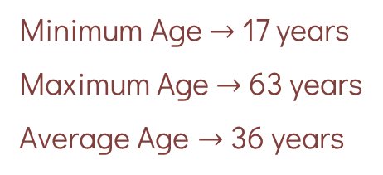
Survey Responses
Ages of people responded to our survey
Minimum Age $→$17 years
Maximum Age $→$ 63 years
Average Age $→$36 years

Slide 8
Survey Responses
Do you think that there is a lack of information available to parents regarding proper education and care for children?
Do you need more information about raising and caring for children?

Slide 9
Survey Responses
Do you think there is a need to conduct special initiatives or programs to educate parents about proper parenting and childcare?

Slide 10
Survey Responses
Resources used to obtain information about raising and caring for children

Slide 11
Some Problems Facing Children
Special Issues and Conditions Requiring Community Support for Children
Parental Influence and Engagement
Peer and Social Pressures
Behavioral and Emotional Challenges
Cultural and Environmental Factors
Early Adolescence
Parental Conflicts
Support for Children of Divorce
Bullying
Building Self-confidence
Moral Values
Influence of Social Media
Special Needs Children
Teenage Relationships
Autism Awareness.
Work of Parents
Positive Role Models
Mental Health Support
Refugee Children
Common Issues Among Children
Psychological and Behavioral Issues
Chronic and Genetic Conditions
Environmental and Lifestyle Factors
Psychosocial and Family Issues
Some Problems Facing Parents
Media, Technology and Influence
Parental Communication and Understanding
Negative Societal Influences
Lack of Parental Awareness

Slide 12
Problem to Solve
The lack of proper guidance and support for parents facing diverse parenting challenges.

Slide 13
Our Objectives
We aim to empower parents with a versatile tool that identifies specific problems and offers tailored solutions and resources. Through a user-friendly mobile app, we provide comprehensive guidance, evidence-based strategies, and dedicated support for special needs.

Slide 14
Previous Solutions
Existing solutions include parenting forums, apps, websites, and behavioral parenting apps. However, they often lack structured and curated content, evidence-based strategies, and a user-friendly interface, leaving parents feeling overwhelmed and isolated.

Slide 15
Related Work

Slide 16





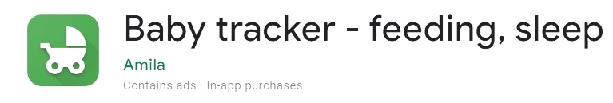
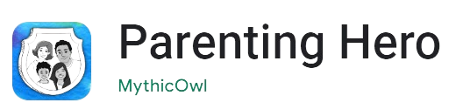



Educational Parenting Websites
Parenting Apps
Parenting Forums
May not address specific challenges faced by parents with older children.
Focuses on predictable fussy periods, might not address individual child development variations.
Advice can be subjective and unverified, accuracy might vary.
Primarily geared towards pregnancy and newborn stages, may not cover later child development.
Primarily focused on health and wellness, may not cover broader parenting topics.
Tracks feeding, sleep, and diaper changes, doesn't offer in-depth developmental advice.
Behavioral Parenting Websites and Apps
Special Needs Parenting Communities
Specific to Autism Spectrum Disorder (ASD), may not address other developmental concerns.
Might rely on generic solutions that don't address the root cause of behavior problems.
May not be suitable for all parenting styles or cultural backgrounds.
Focuses on specific conditions, may not be helpful for parents with children with different needs.

Slide 17
Educational Parenting Websites
Parenting Apps
Behavioral Parenting Websites and Apps
Special Needs Parenting Communities
Parenting Forums
Parent Pal

Slide 18
03. Project Specifications

Slide 19
Stakeholders
Parents & Caregivers
Children
Experts & Consultants
App Administrators.
Non-Functional Requirements
Security
Scalability
Usability
Reliability
Data privacy.

Slide 20



Technologies Used
Our Project is developed using Flutter and Dart for cross-platform compatibility and efficient development. Integrated with Firebase for real-time updates, secure data storage, and collaborative features.

Slide 21
04. Conclusion
Parent Pal aims to revolutionize the way parents approach parenting challenges by providing a comprehensive and user-friendly solution.
By addressing the lack of proper guidance, offering evidence-based resources, and catering to special needs, we strive to create a supportive and informed parenting community.
With our innovative approach and dedication to empowering parents, we aim to make a positive impact on families worldwide.

Slide 22
05. System Design

Slide 23
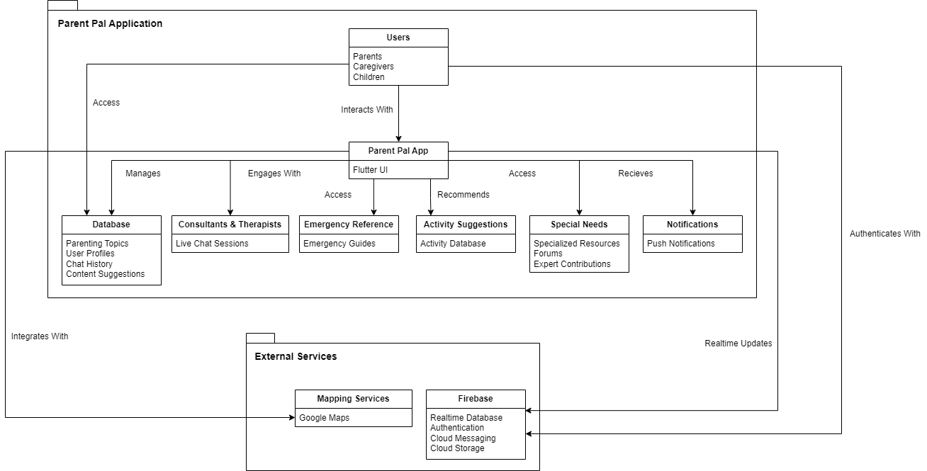
System Architecture Diagram

Slide 24
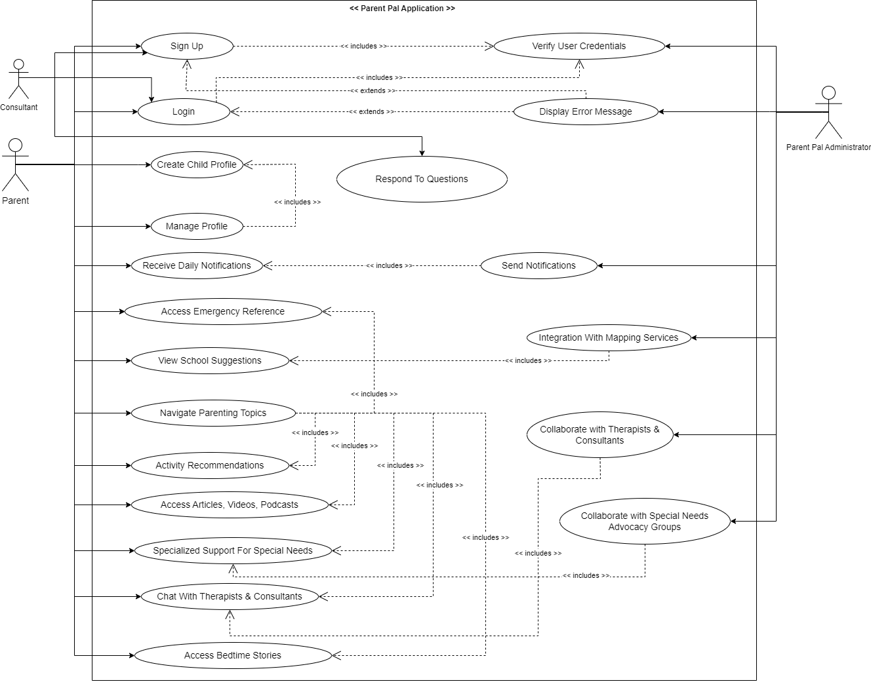
Use Case Diagram

Slide 25
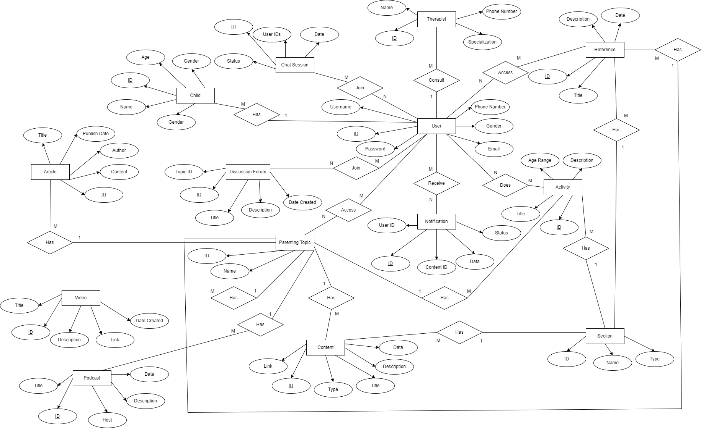
Entity Relationship Diagram

Slide 26
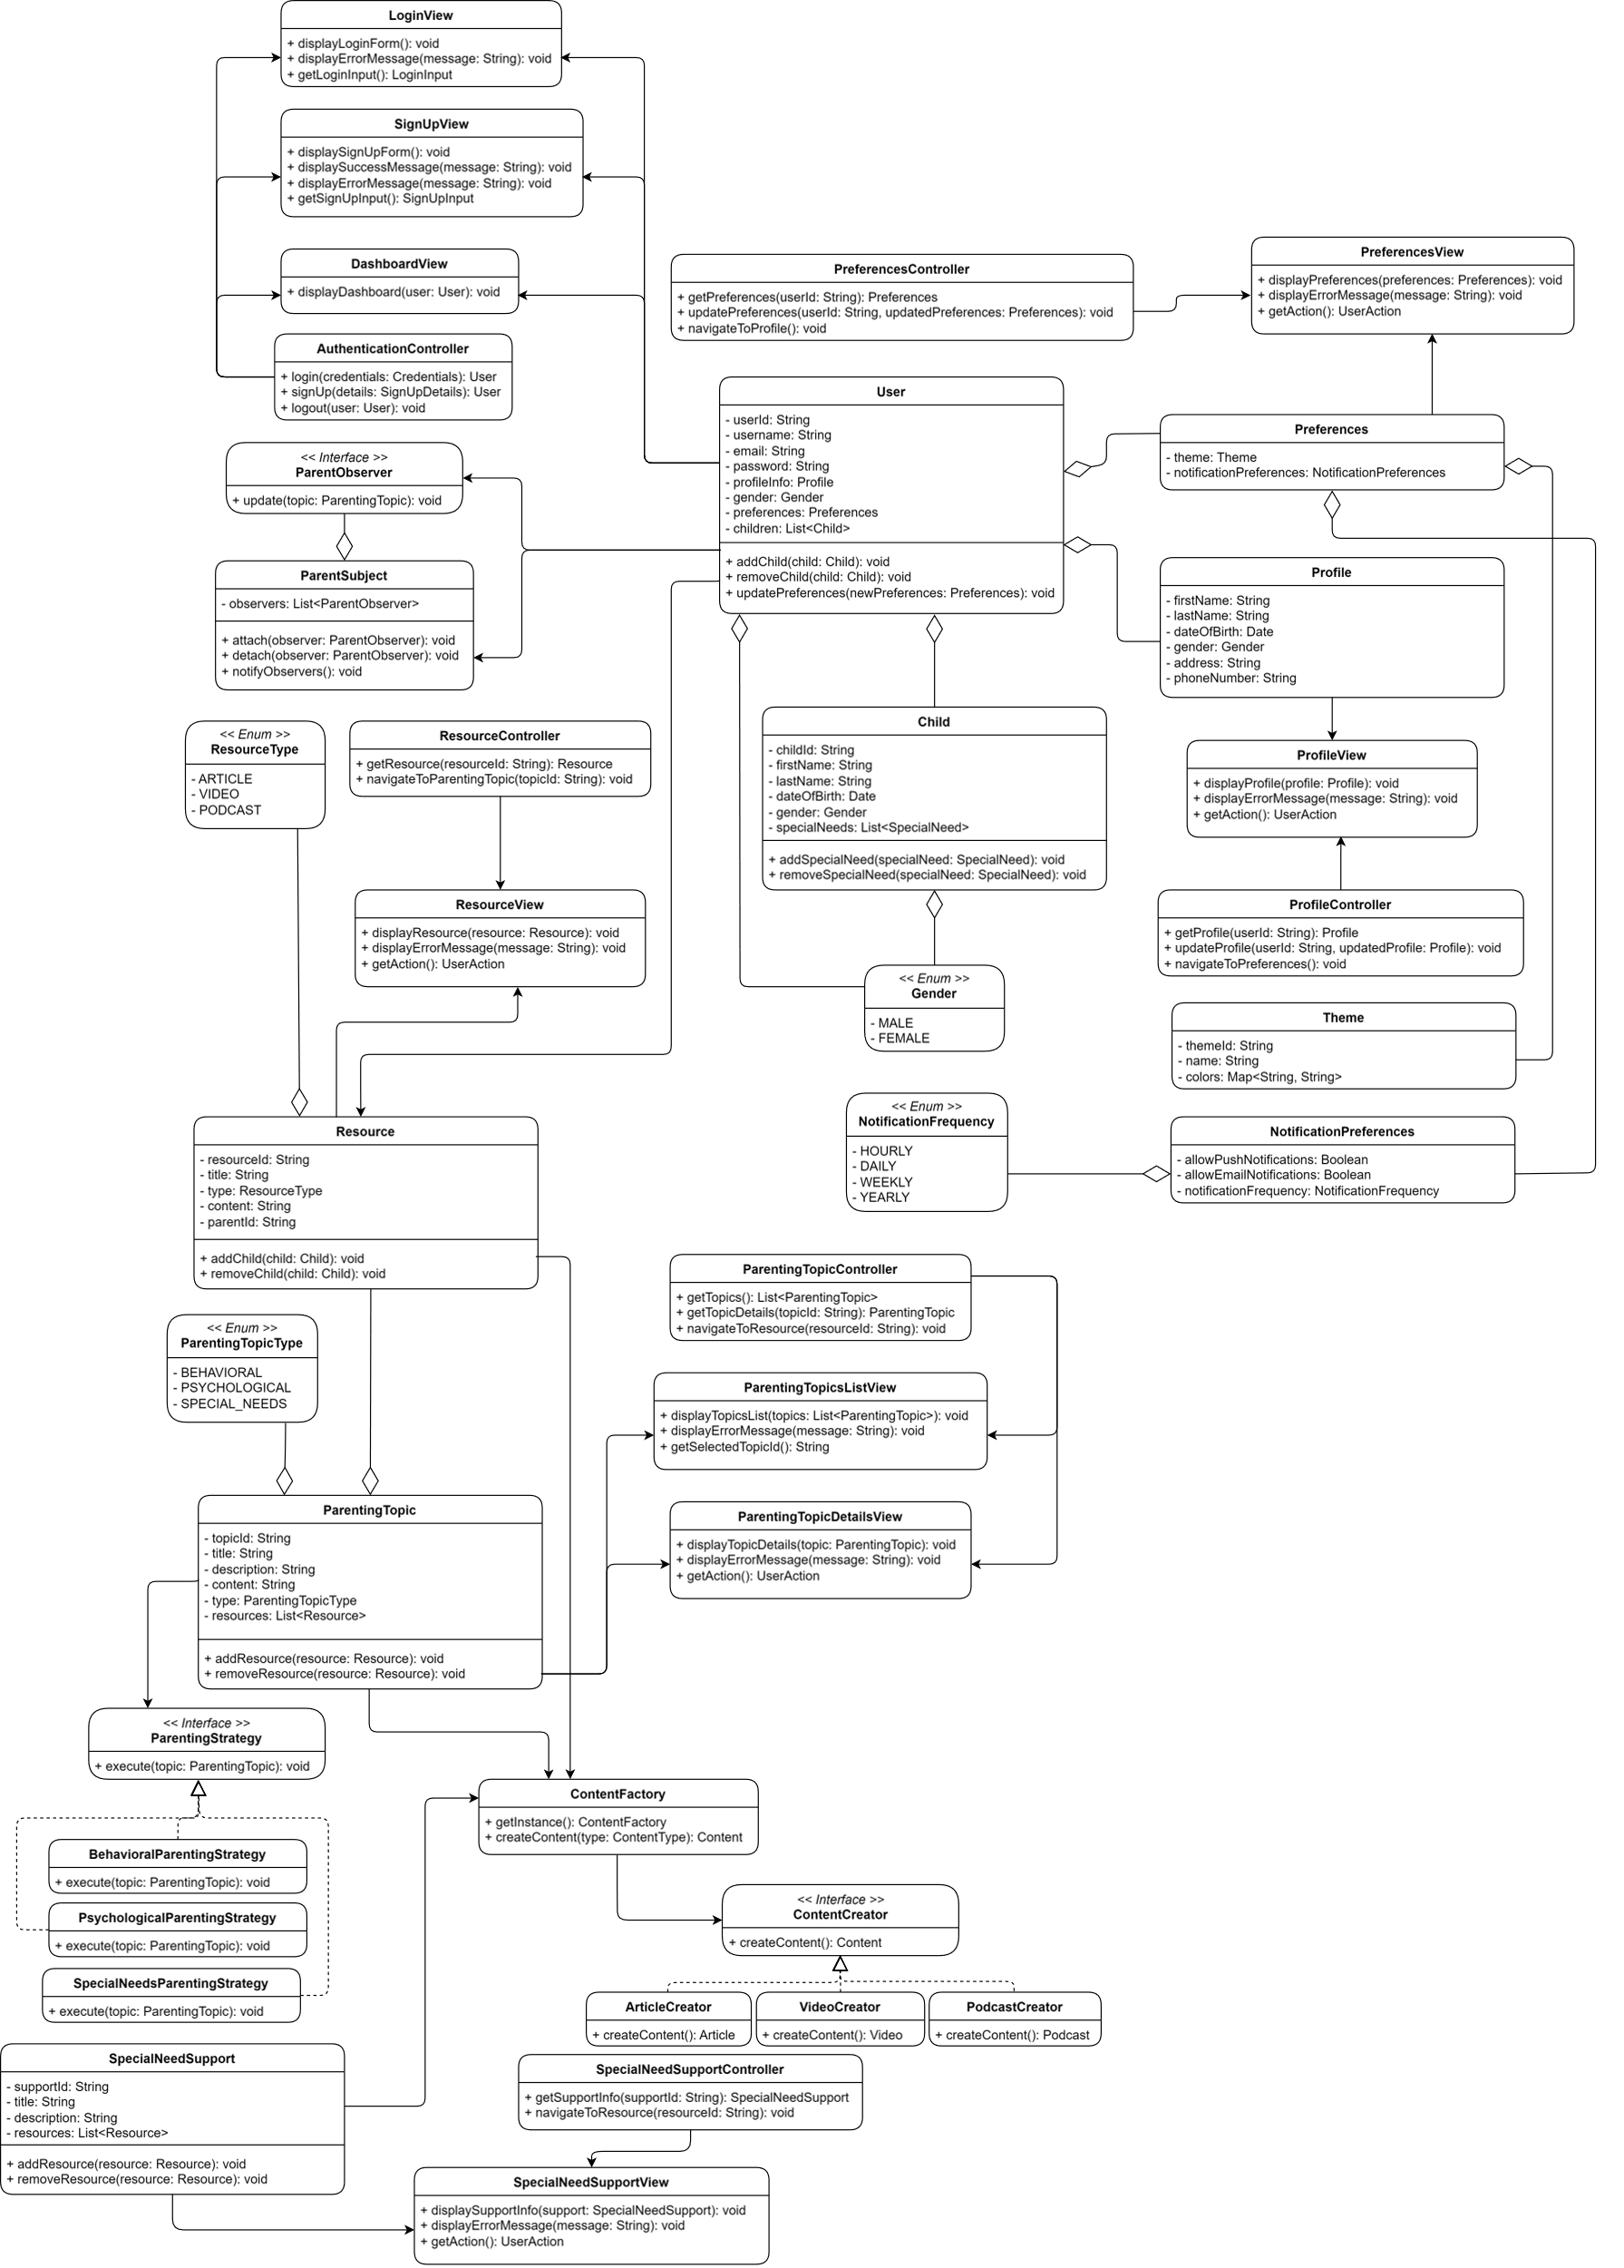
Class Diagram

Slide 27
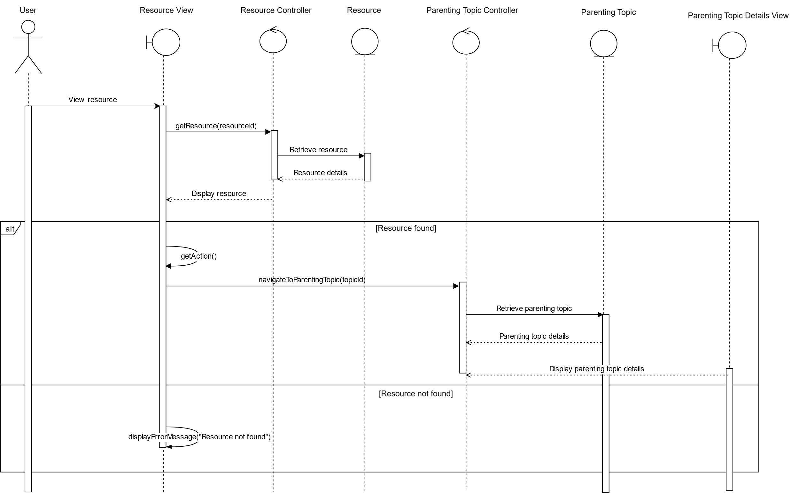
Sequence Diagram

Slide 28
06. Demo

Slide 29
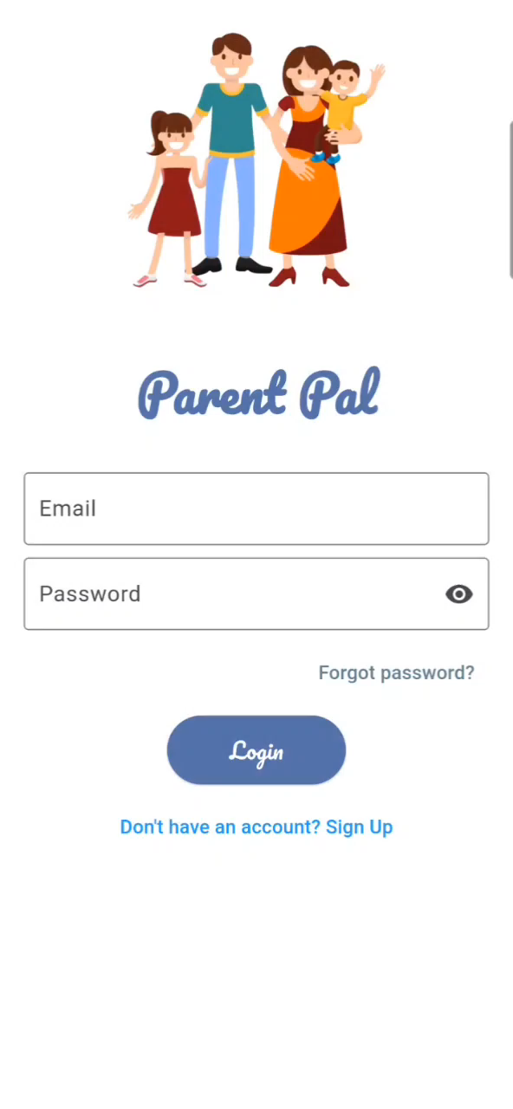
Demo Video
A demo video for our application to show the app's features, functionalities and user interface

Slide 30
Application Screens

Slide 31
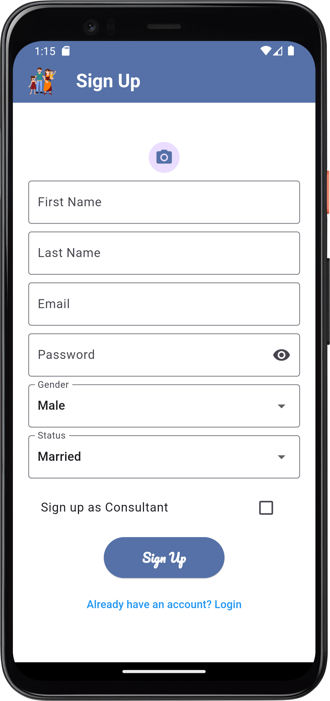
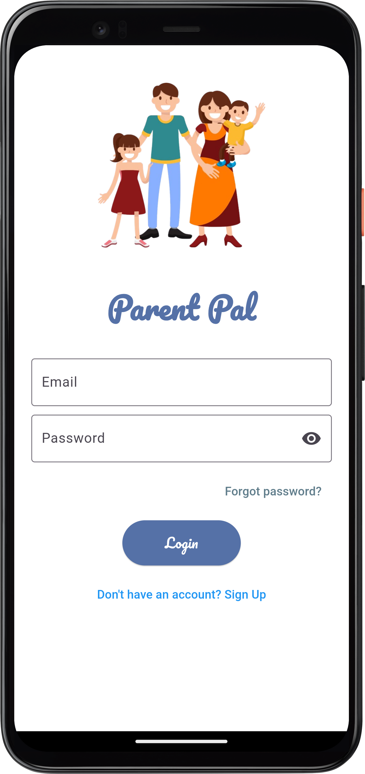
Authentication
The login or sign up page allows users to access the app by either logging in with existing credentials or signing up for a new account using Firebase Authentication and the data of the user is stored under a collection of users in Firebase Cloud Firestore.
Users can have three roles: Parent, Pregnant Woman, Consultant

Slide 32
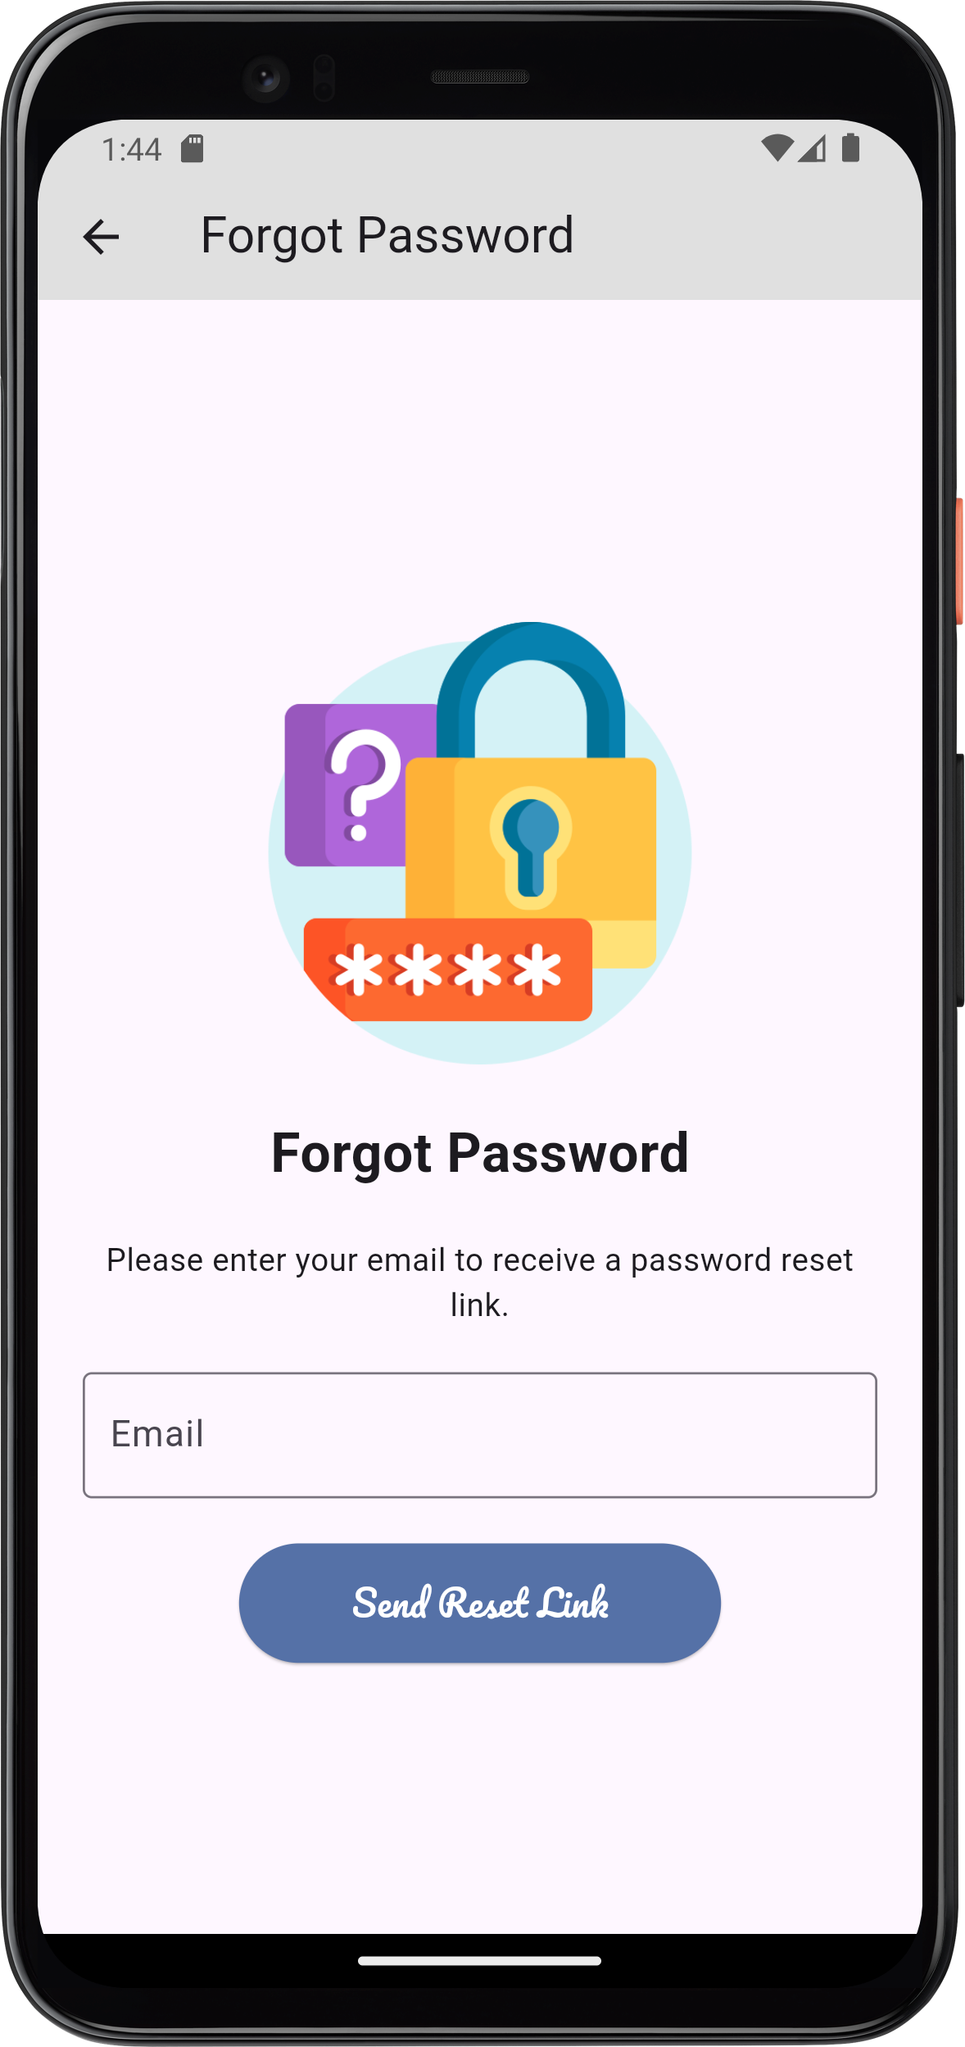
Forgot Password
Handle password resetting by sending reset link through the email to let the user reset his own password in case the user forgot it

Slide 33
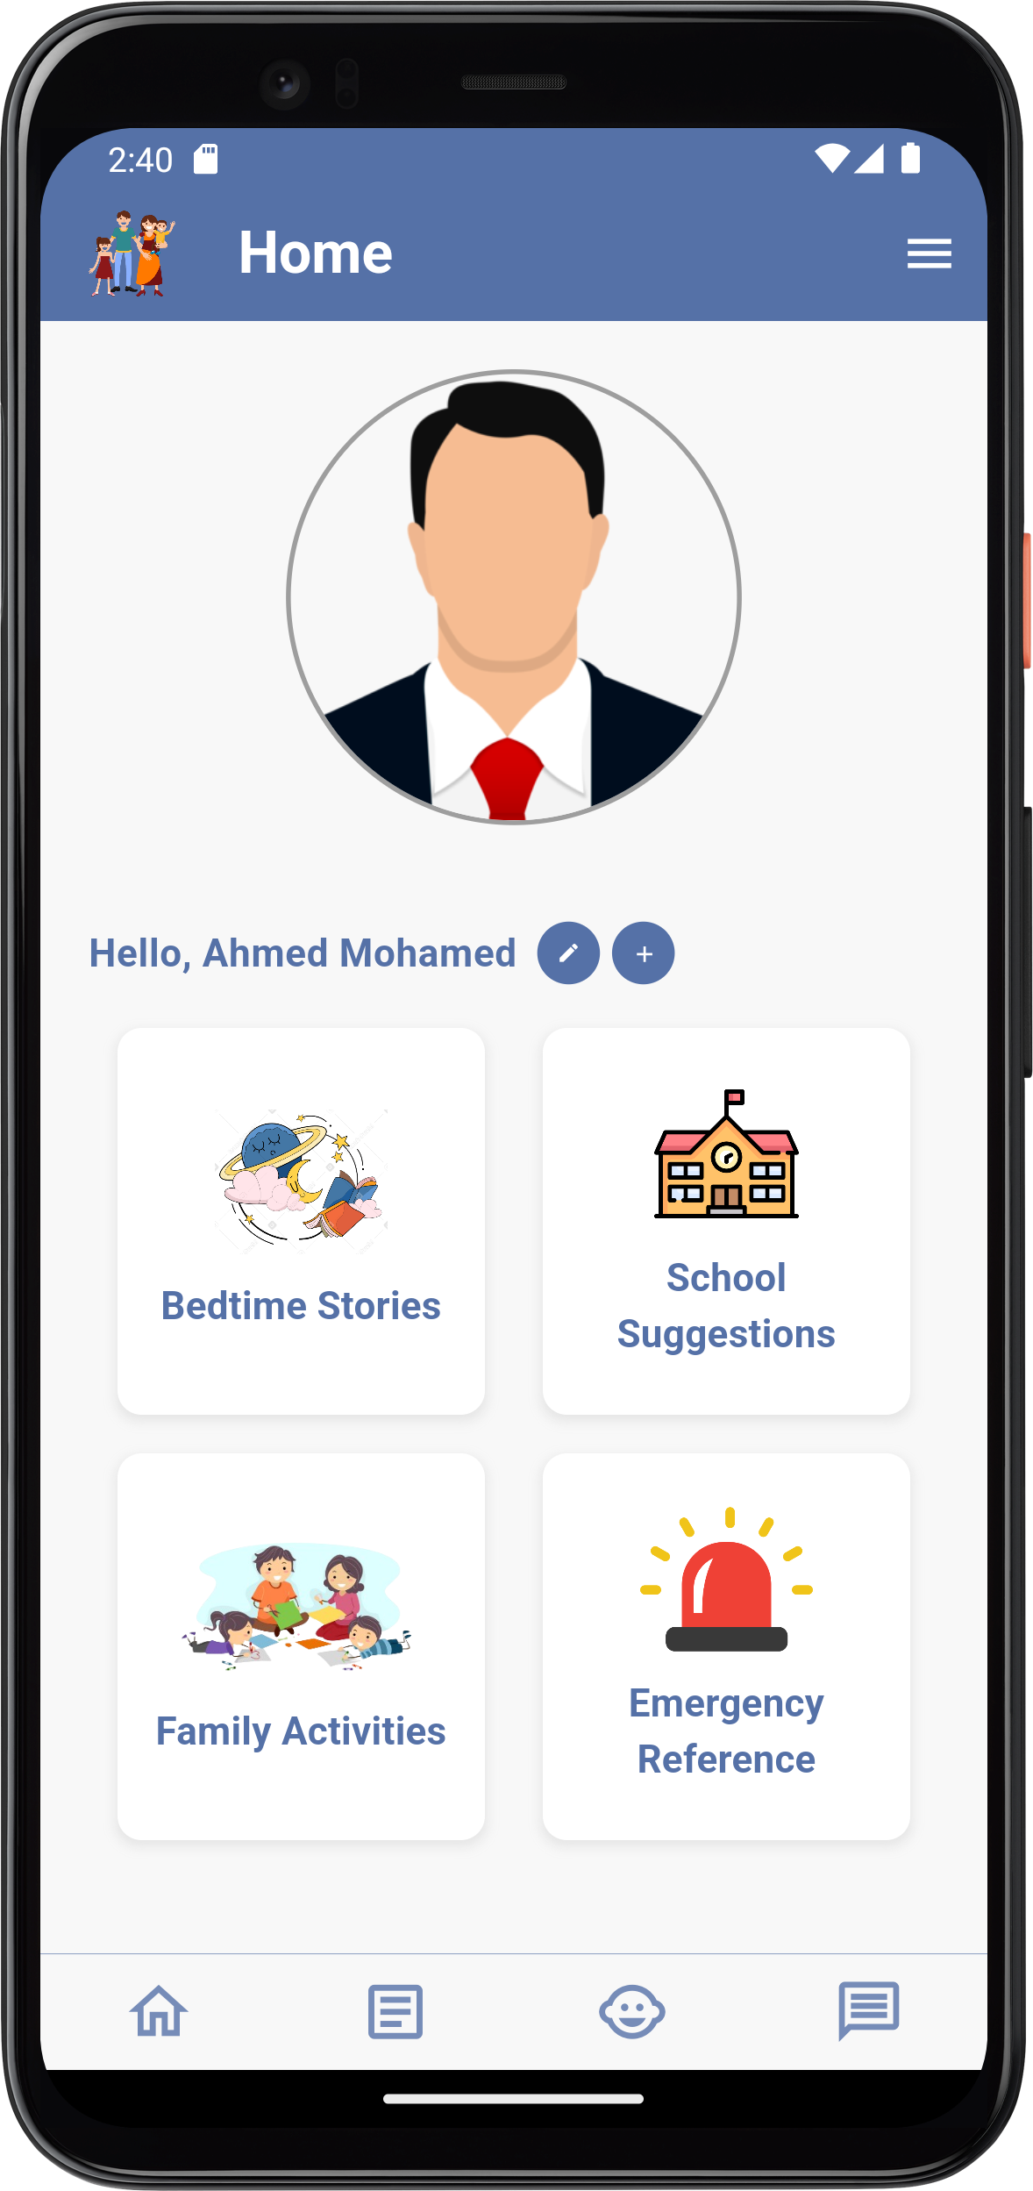
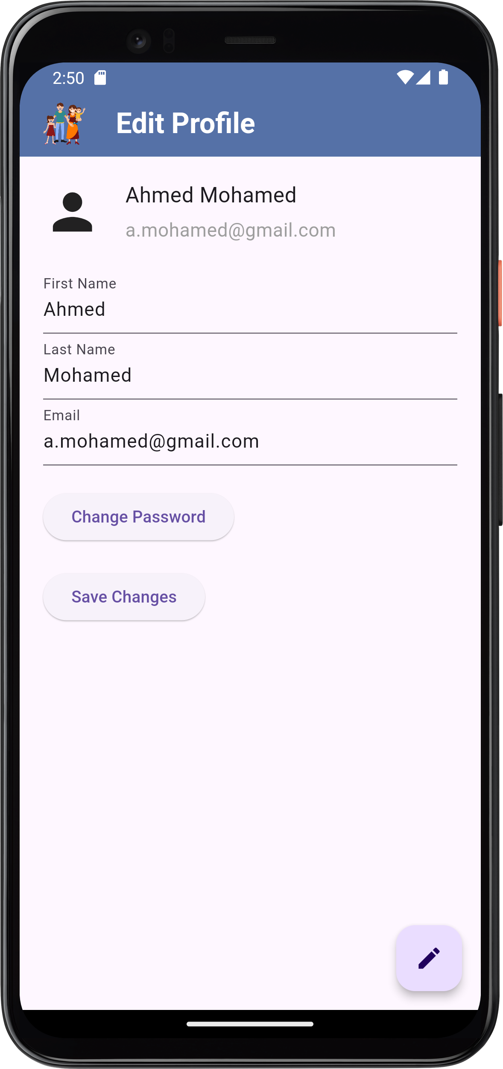
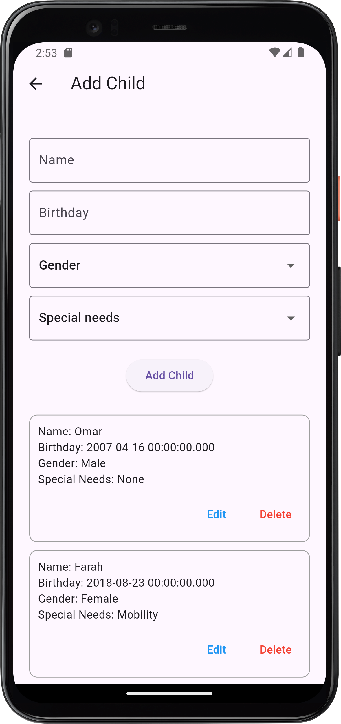
Parent Homepage
User can login having the role of a parent, his home page displays his profile picture and sections he can have access to and also he can edit his profile data and the changes are reflected in the database or add or edit data of his children

Slide 34
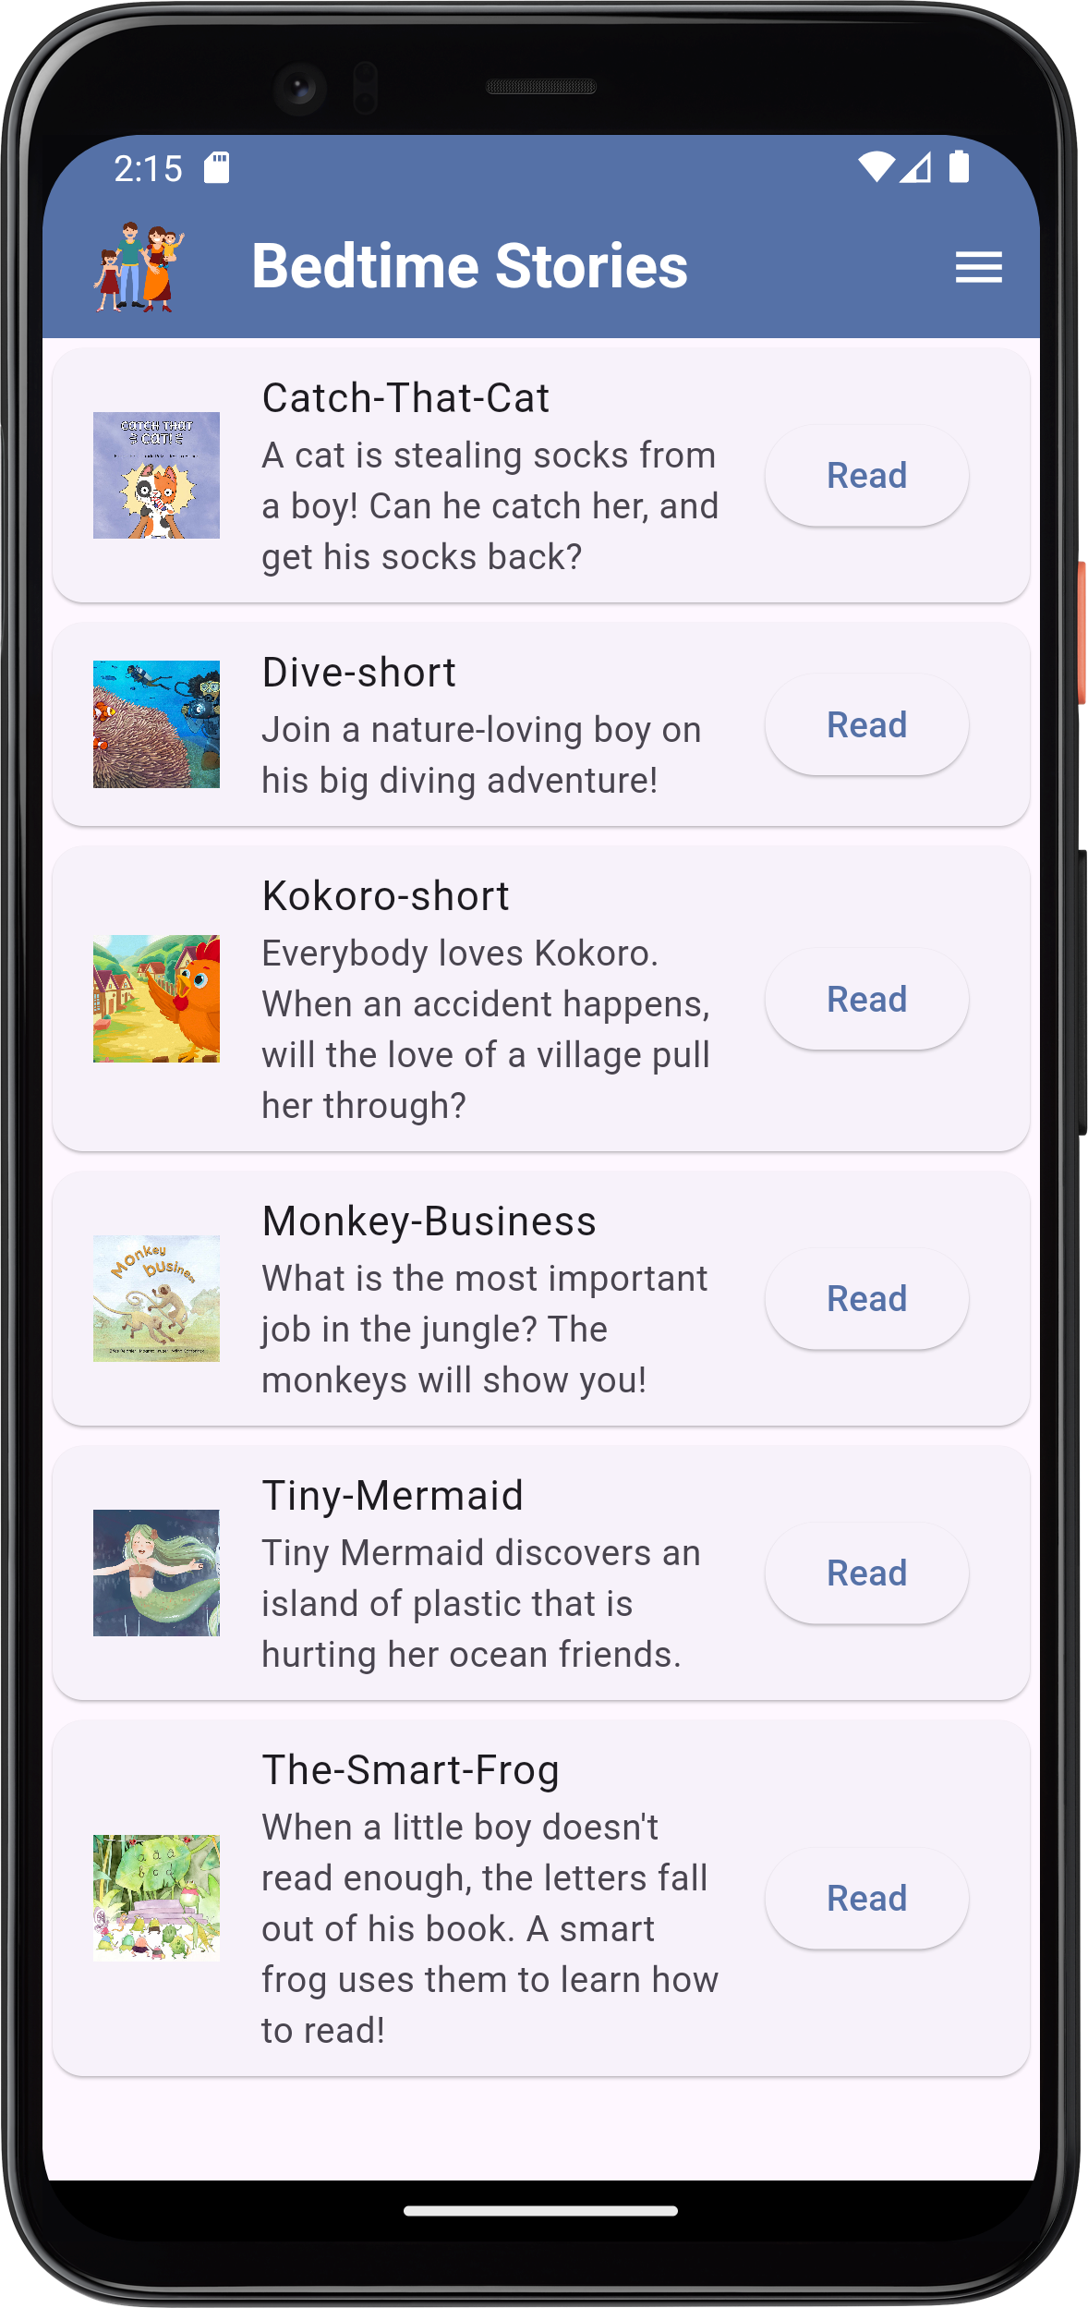
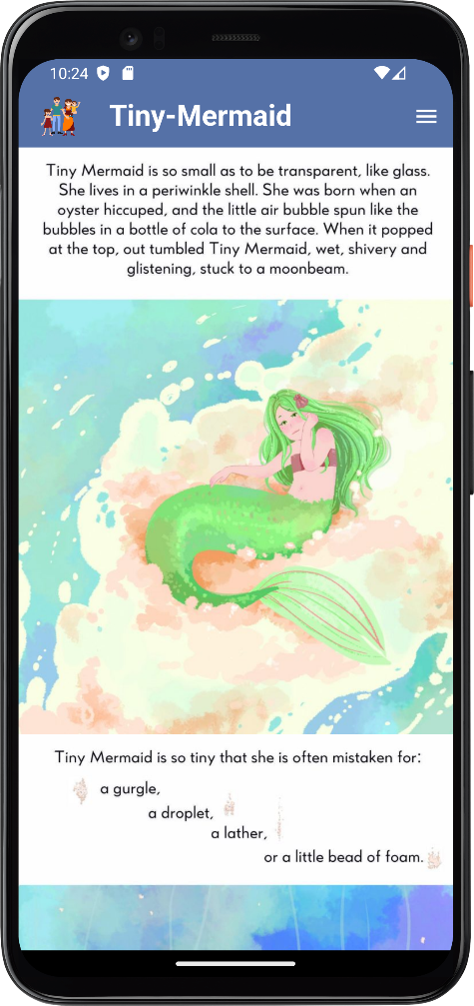
Children can enjoy this application by reading some interesting bedtime stories
Bedtime Stories

Slide 35
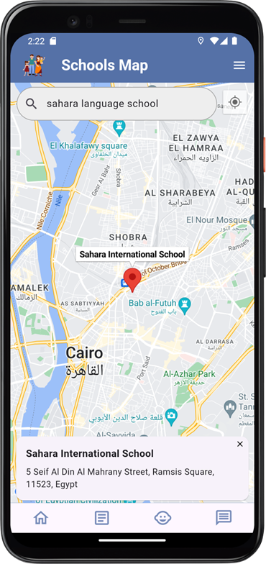
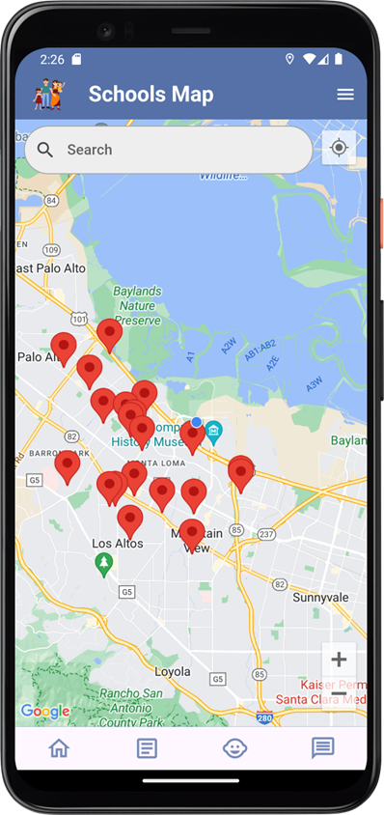
We integrated our application to Google Maps so that parents can find information about nearby schools at a range of 5 kilometers to their current location and search for a specific school on the map
Suggest Nearby Schools

Slide 36
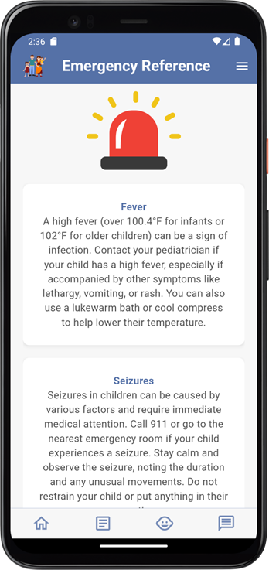
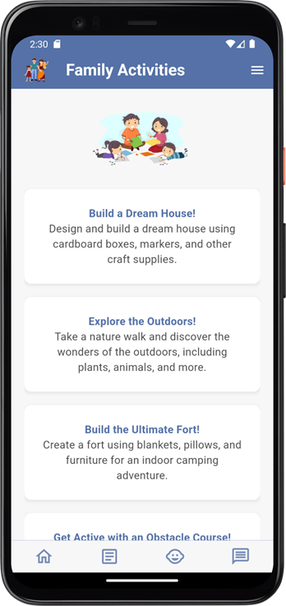
Emergency Reference
Parents can read about some emergencies that might happen to their children and find guidance on what to do in each case
Parents can discover some activities to do with their children
Family Activities

Slide 37
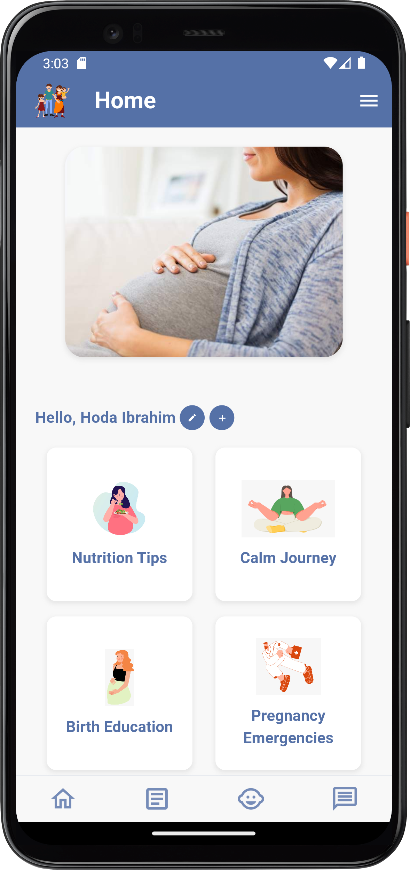
Pregnant Homepage
User can also login as a pregnant woman, her home page displays sections that she can have access to and also he can edit her profile data and add or edit data of her children

Slide 38
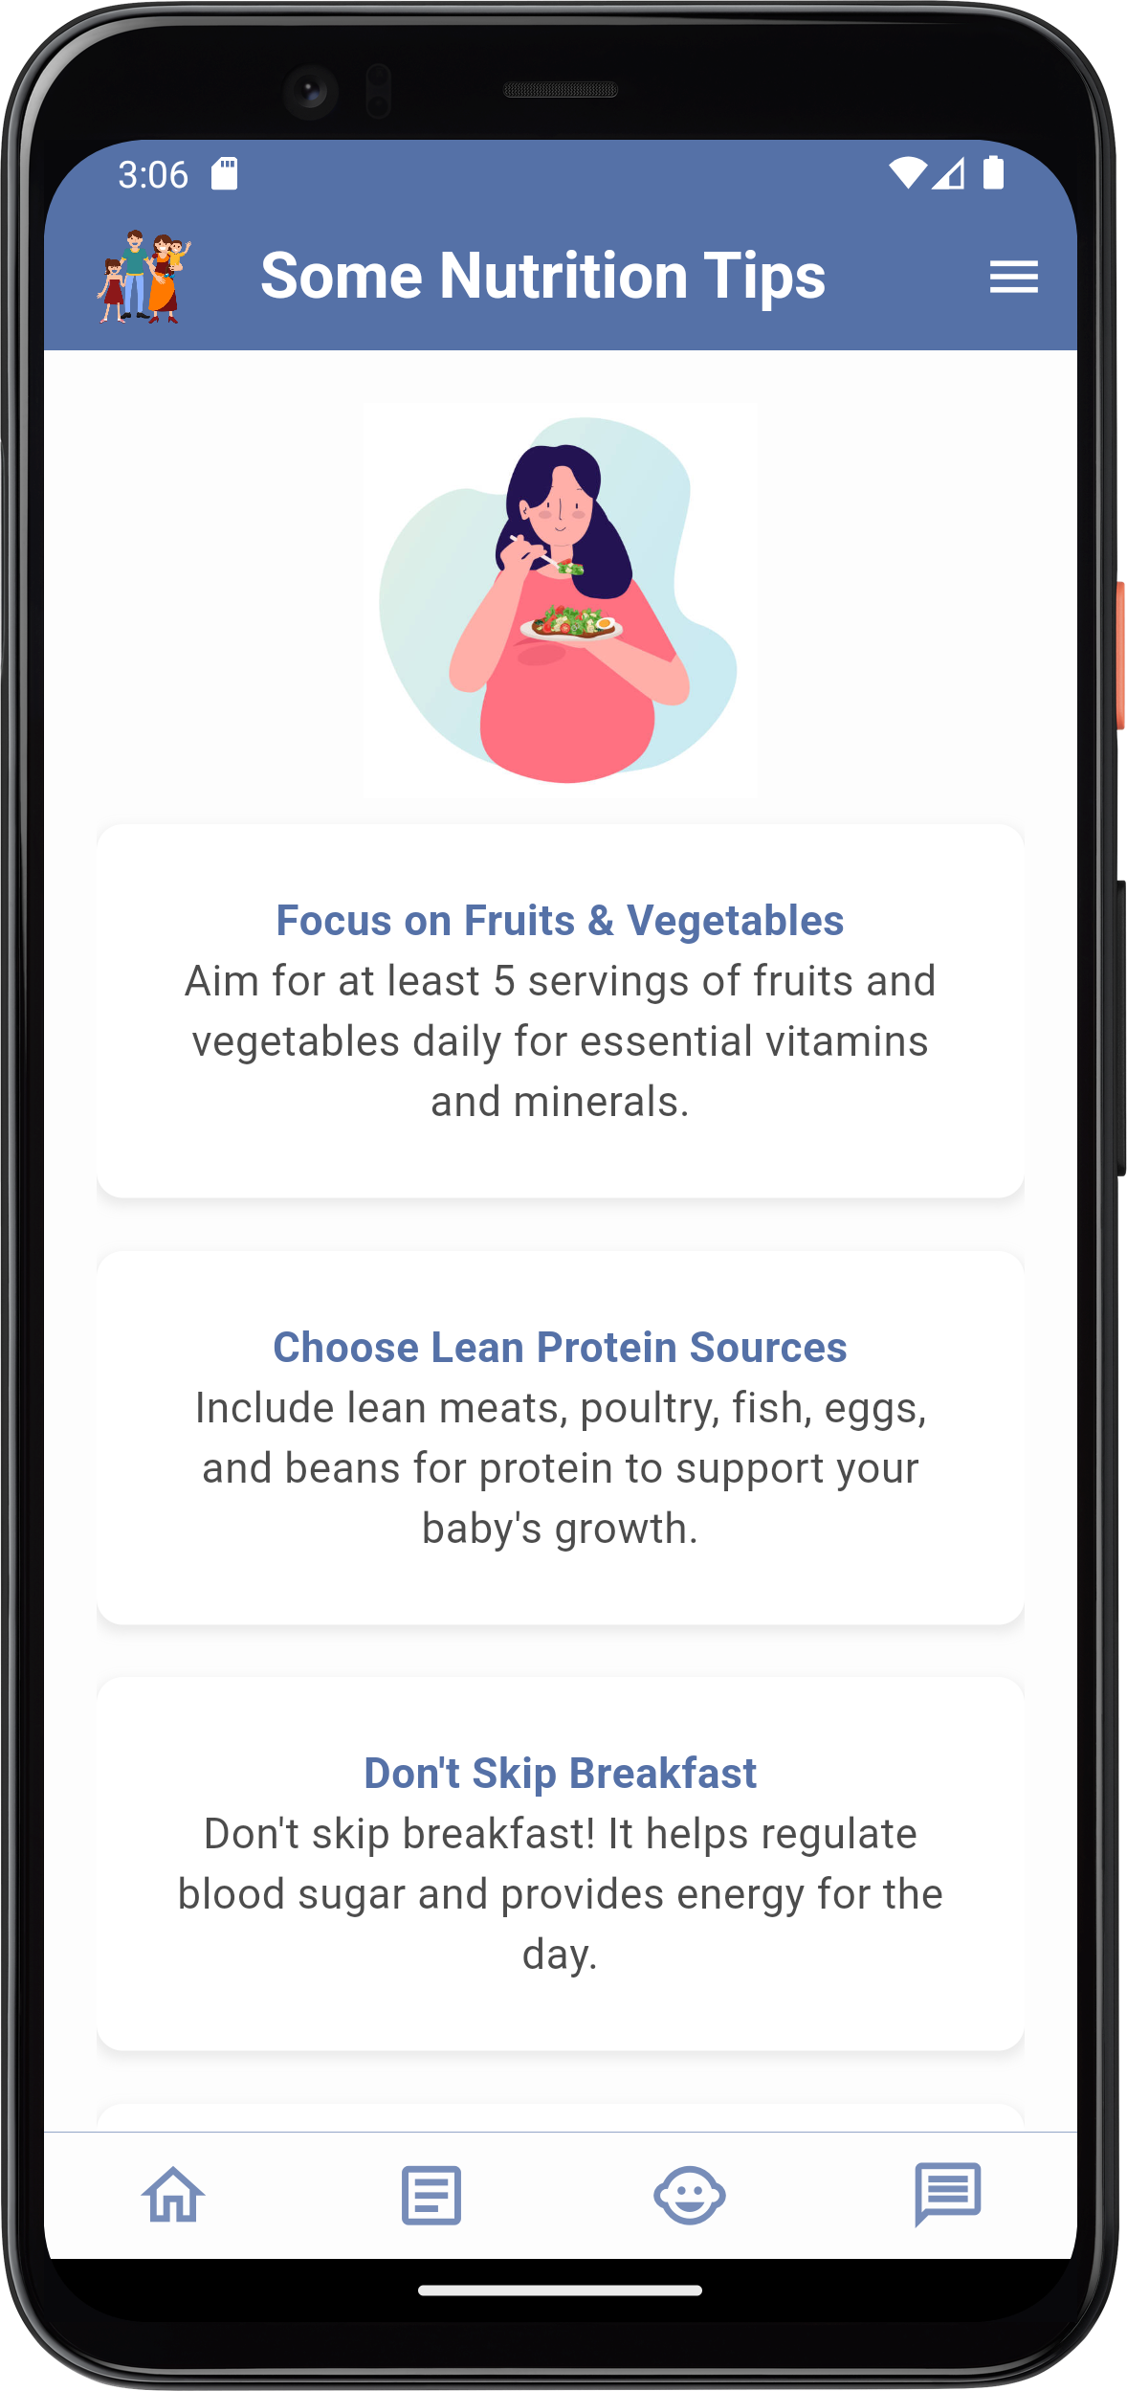
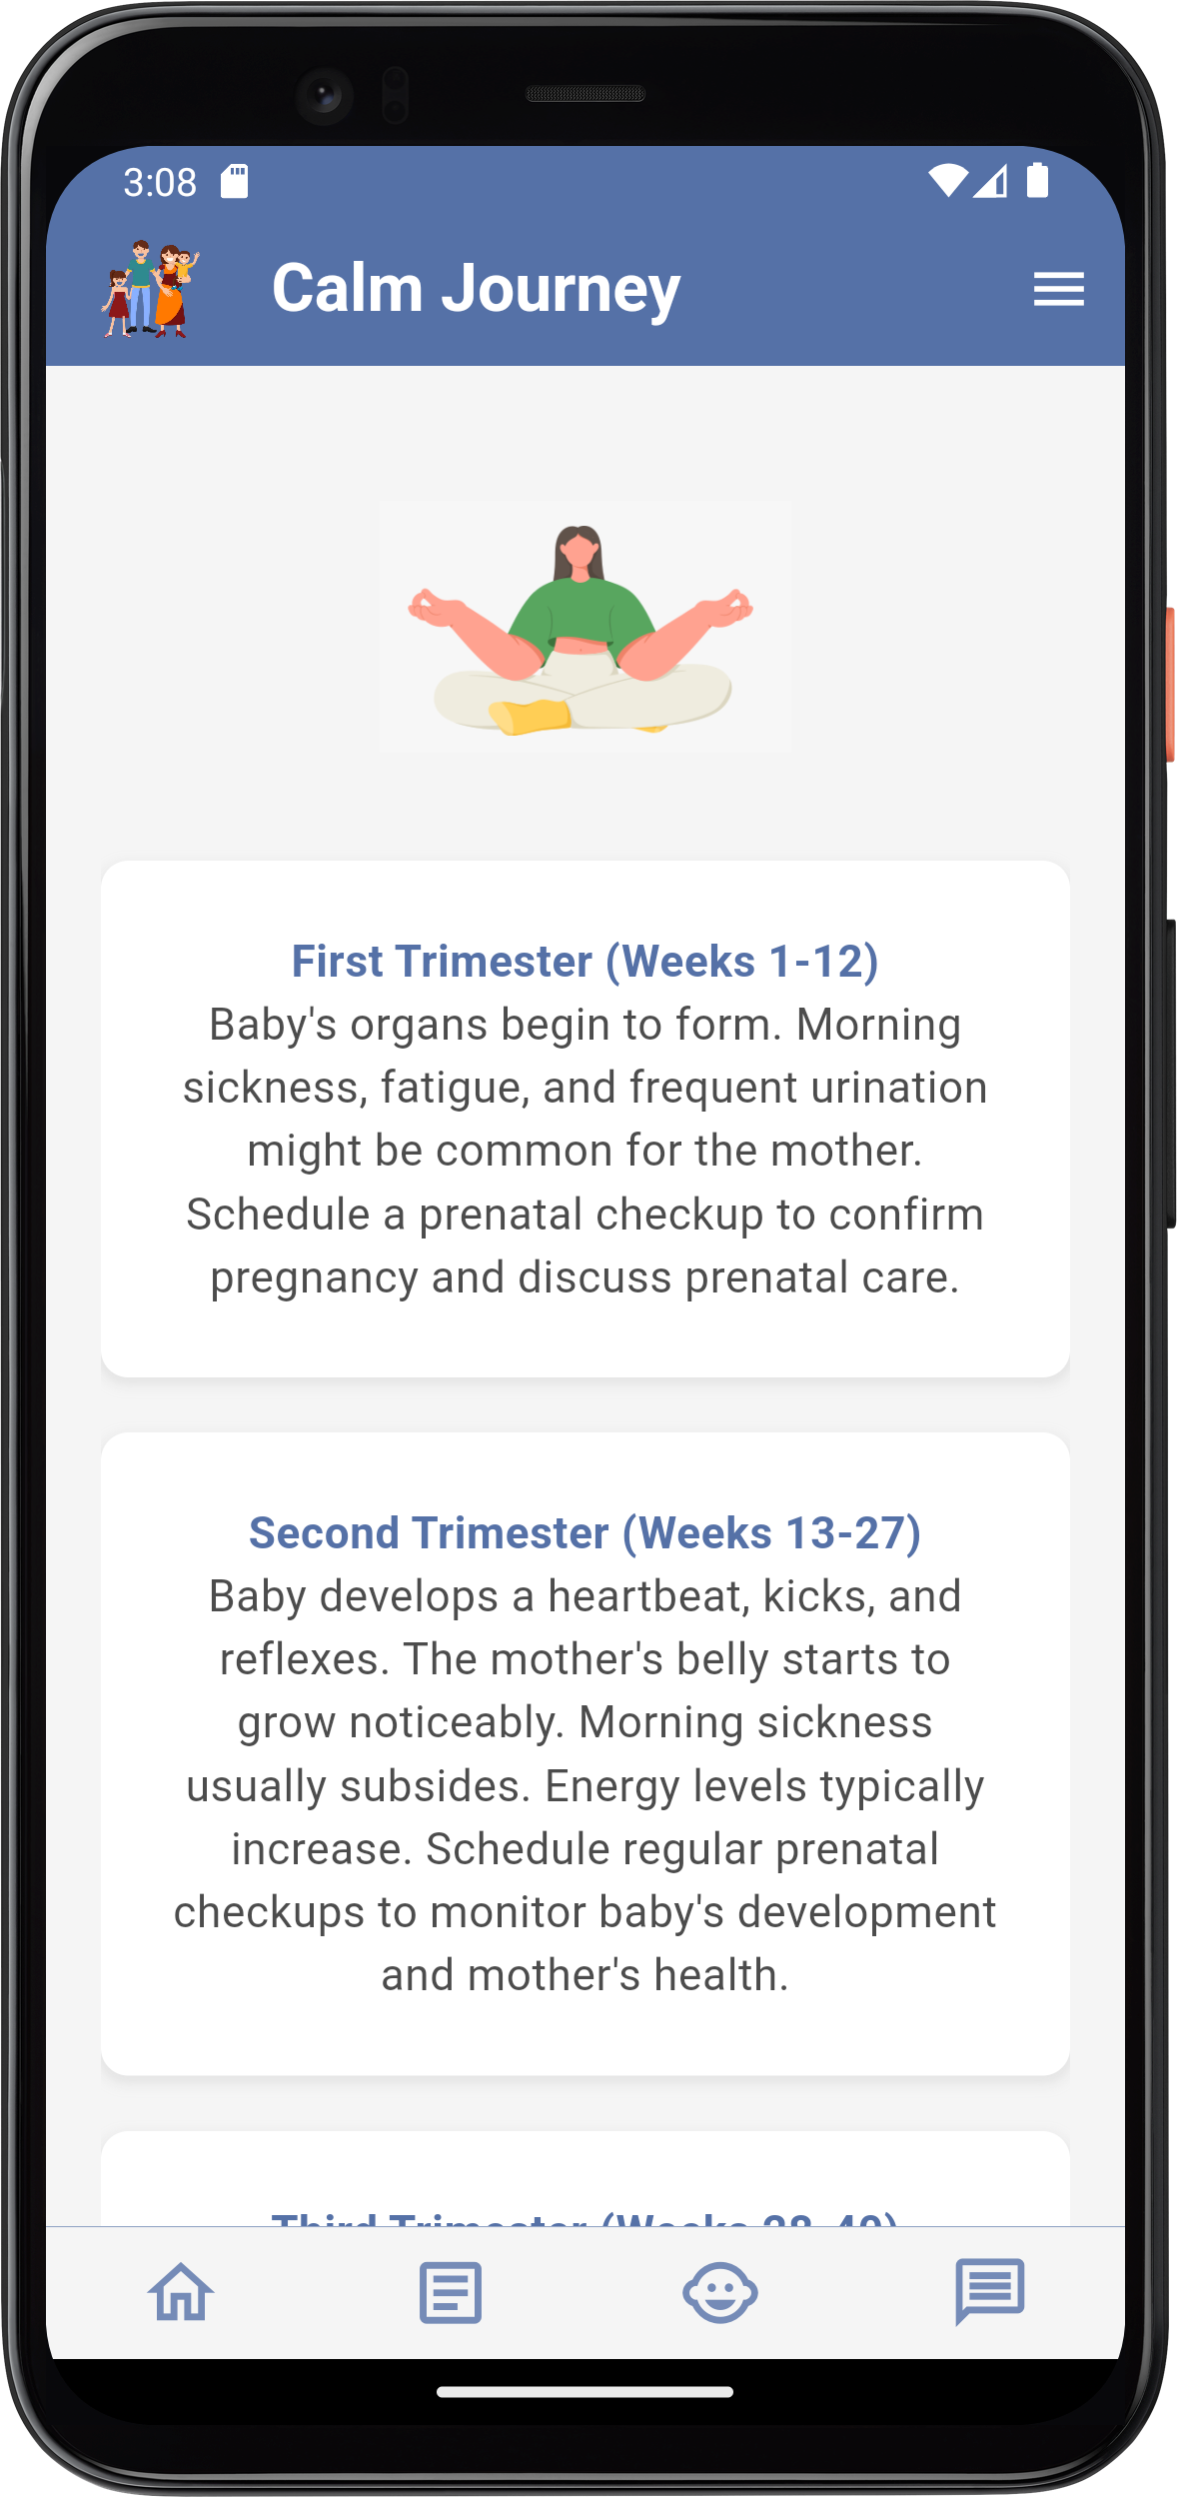
Nutrition Tips
Provide some nutrition tips for pregnant women to follow during her pregnancy journey
Calm Journey
Pregnant women can read about the stages of their pregnancy journey and know about what happens in each pregnancy stage

Slide 39
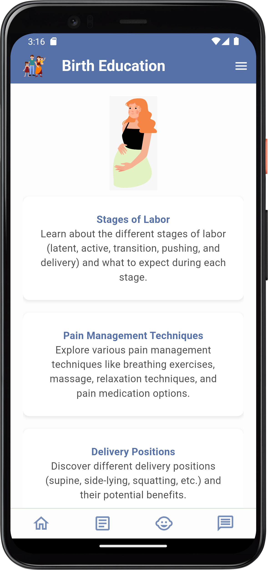
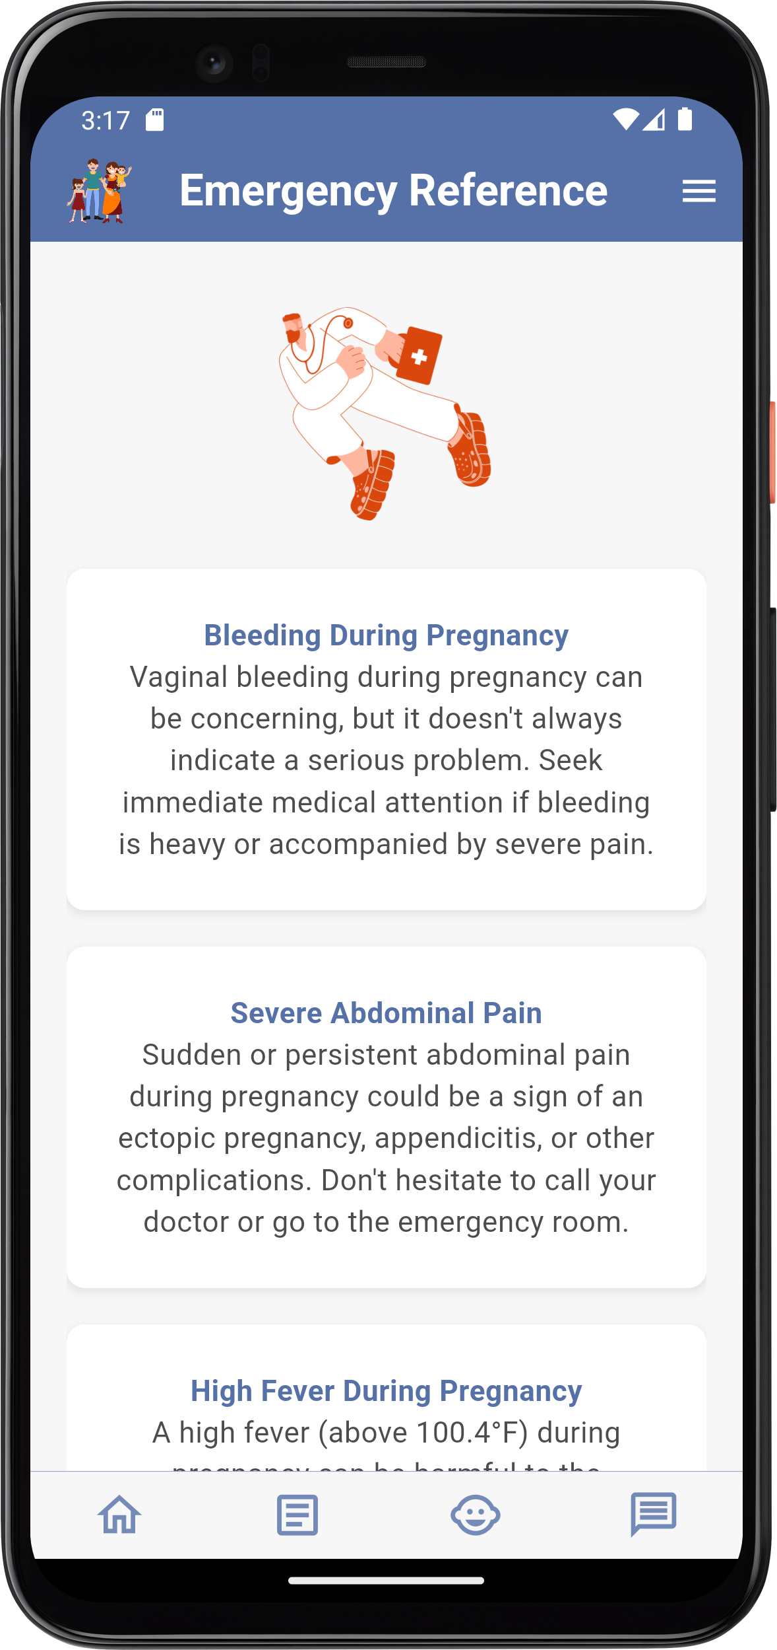
Birth Education
Birth education is designed to help pregnant women access accurate and up to date information about childbirth and make informed decisions about their care.
Pregnancy Emergencies
Emergency reference for emergencies that might happen to them during their pregnancy journey and find guidance on what to do in each case

Slide 40
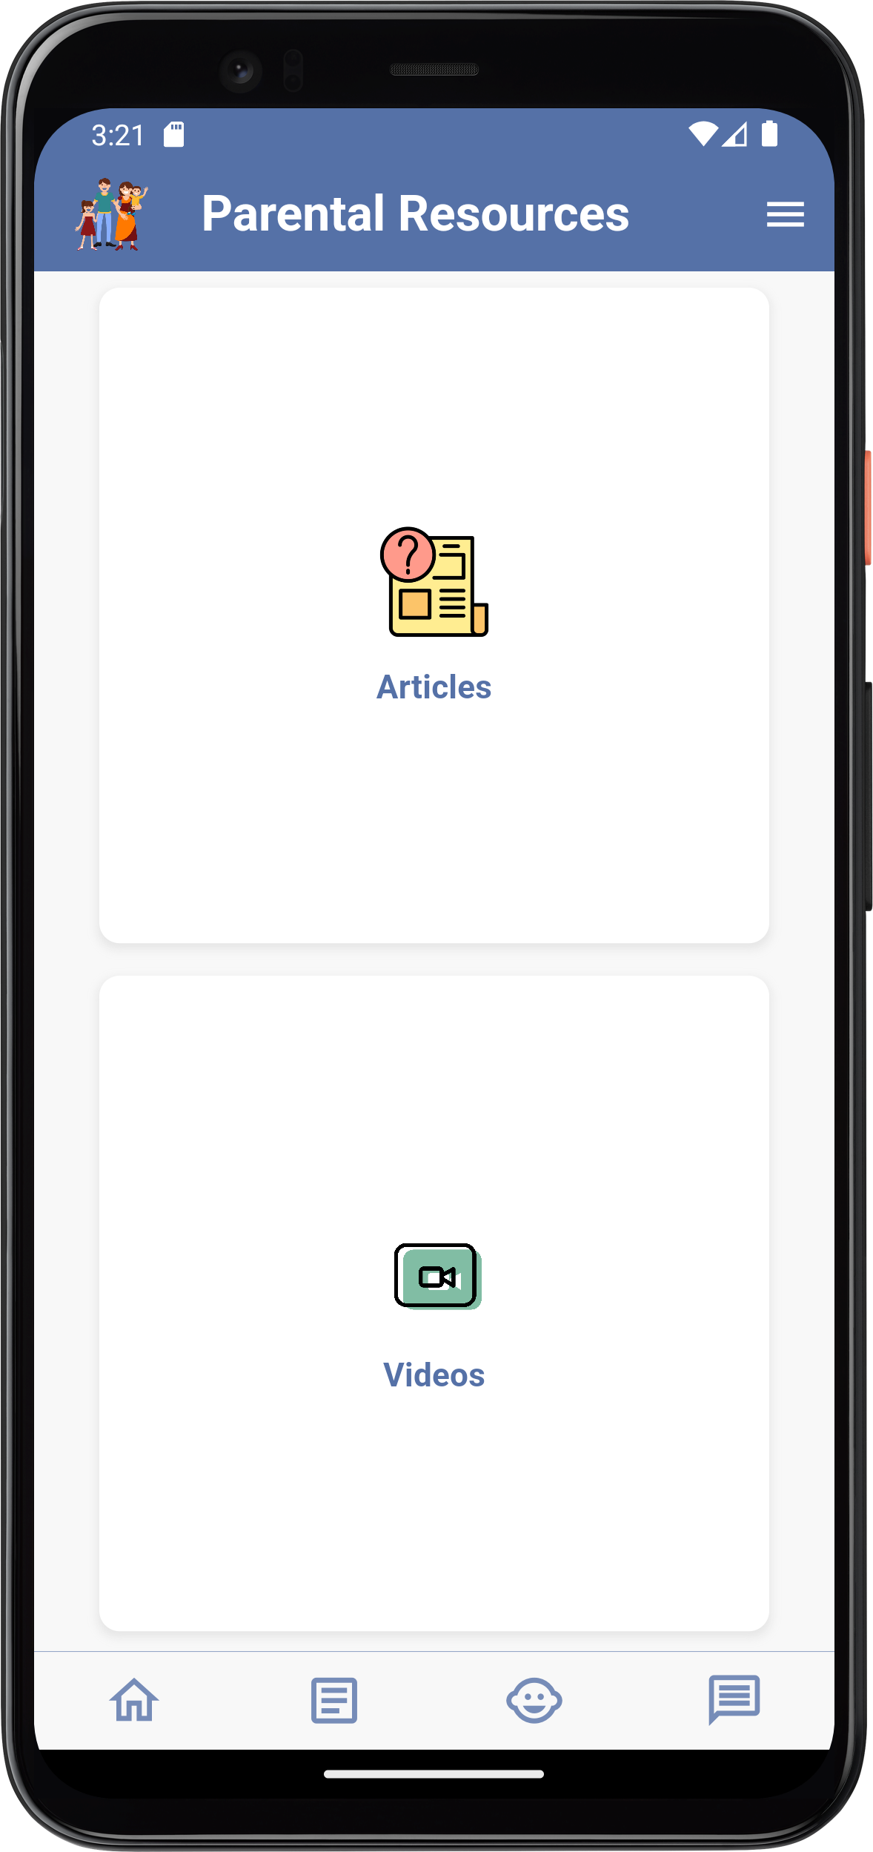
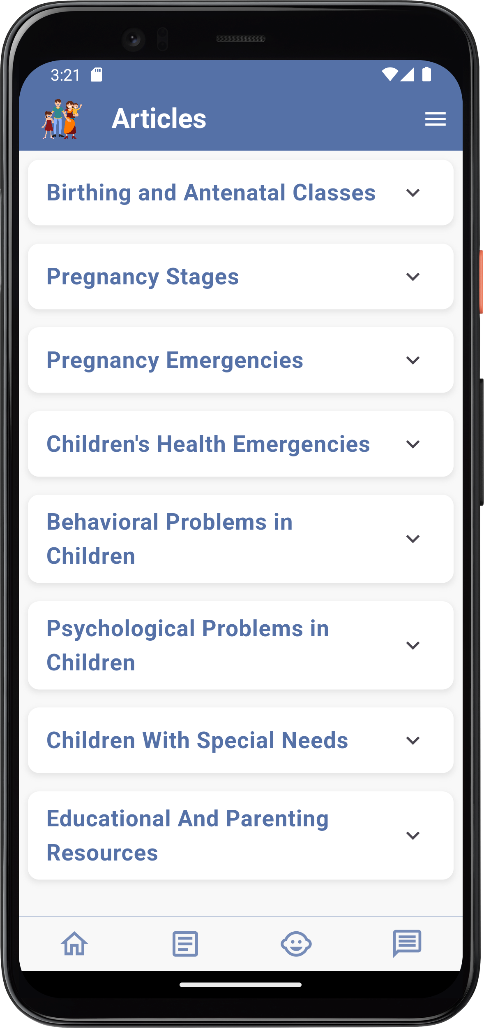
Users can have access to some article and videos concerning some important parental topics
Parental Resources

Slide 41
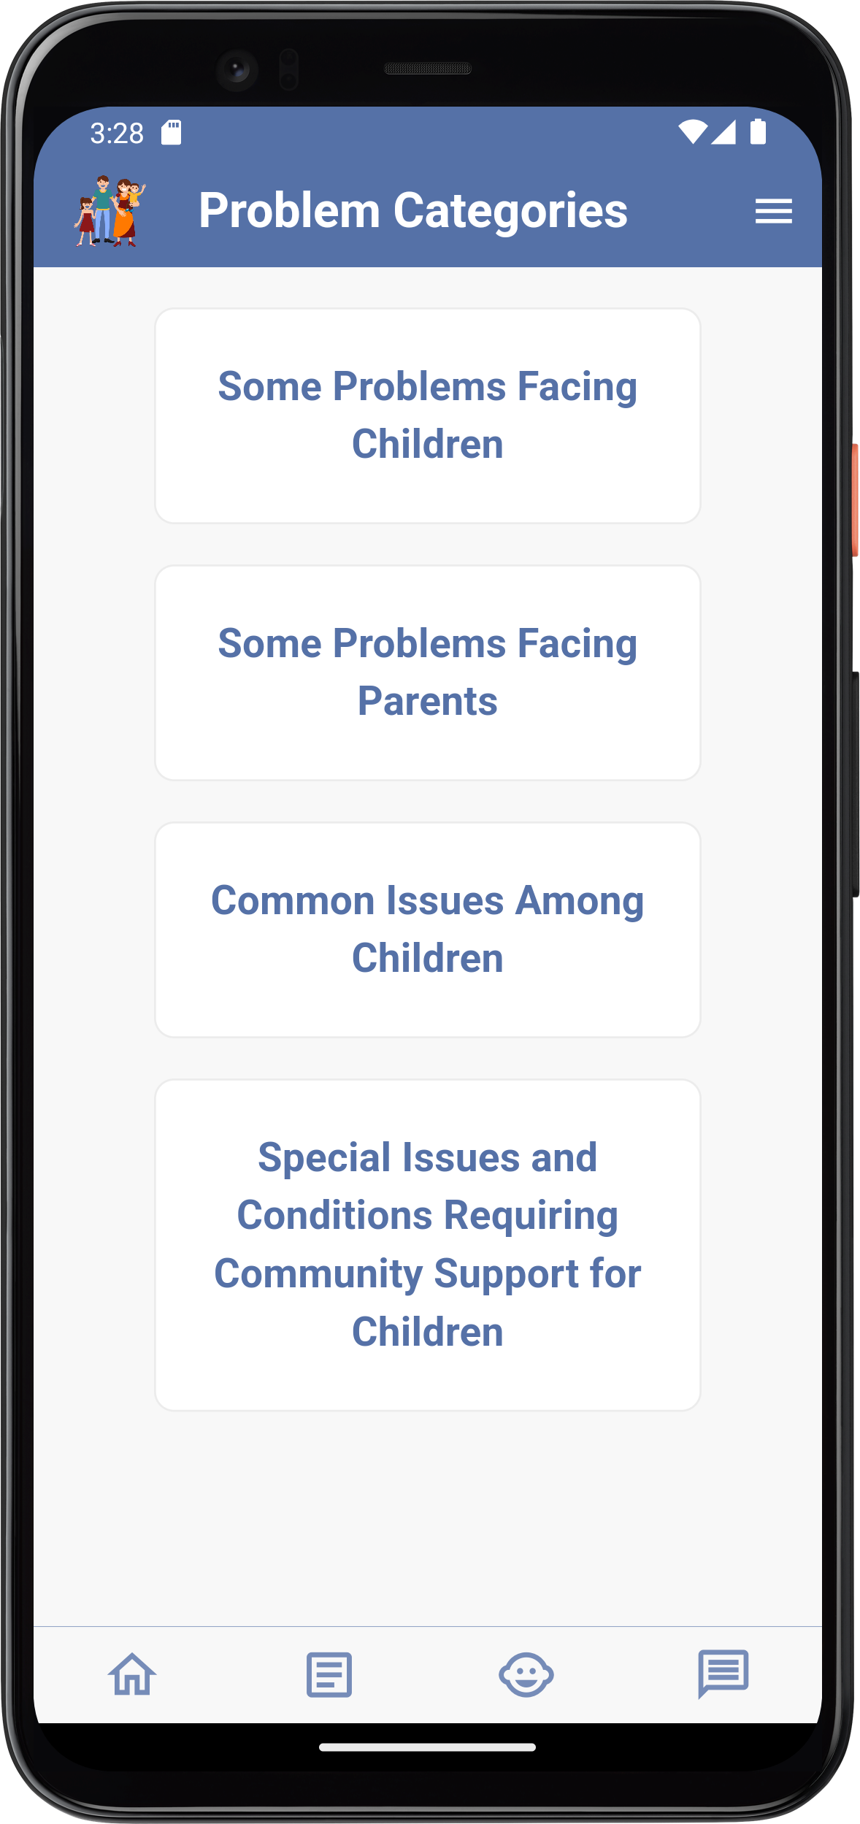
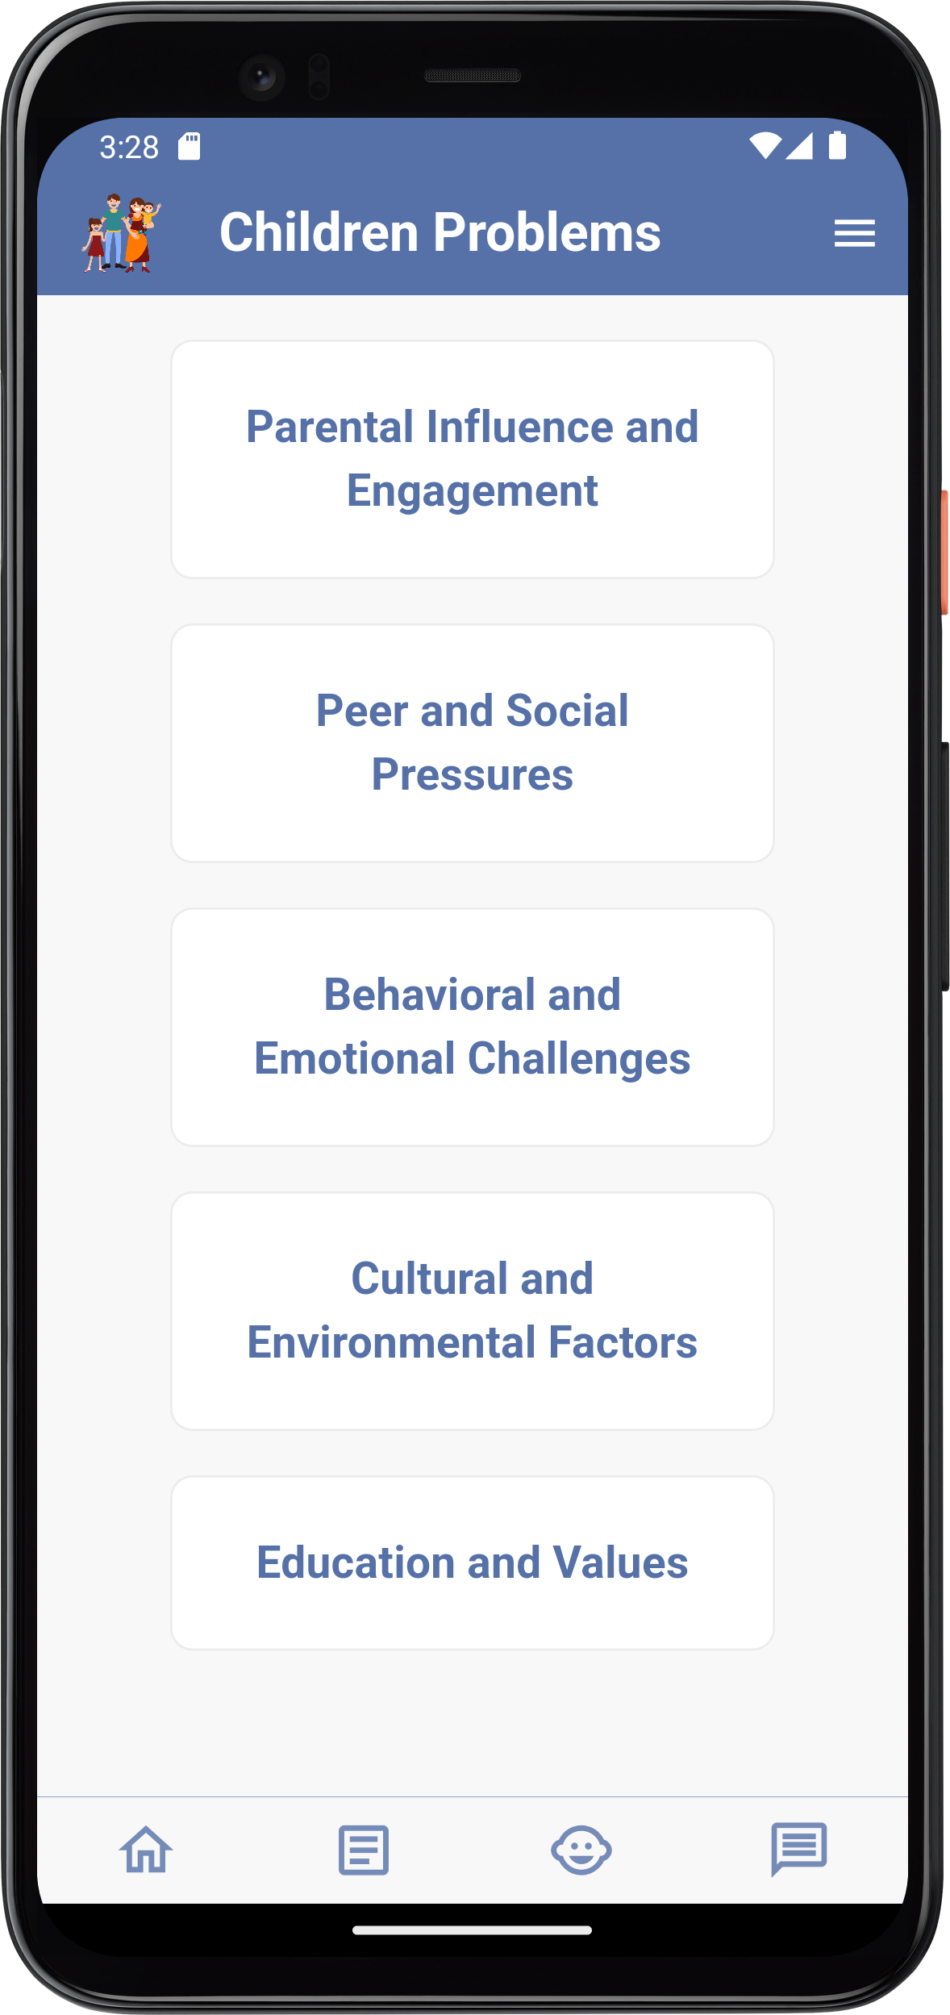
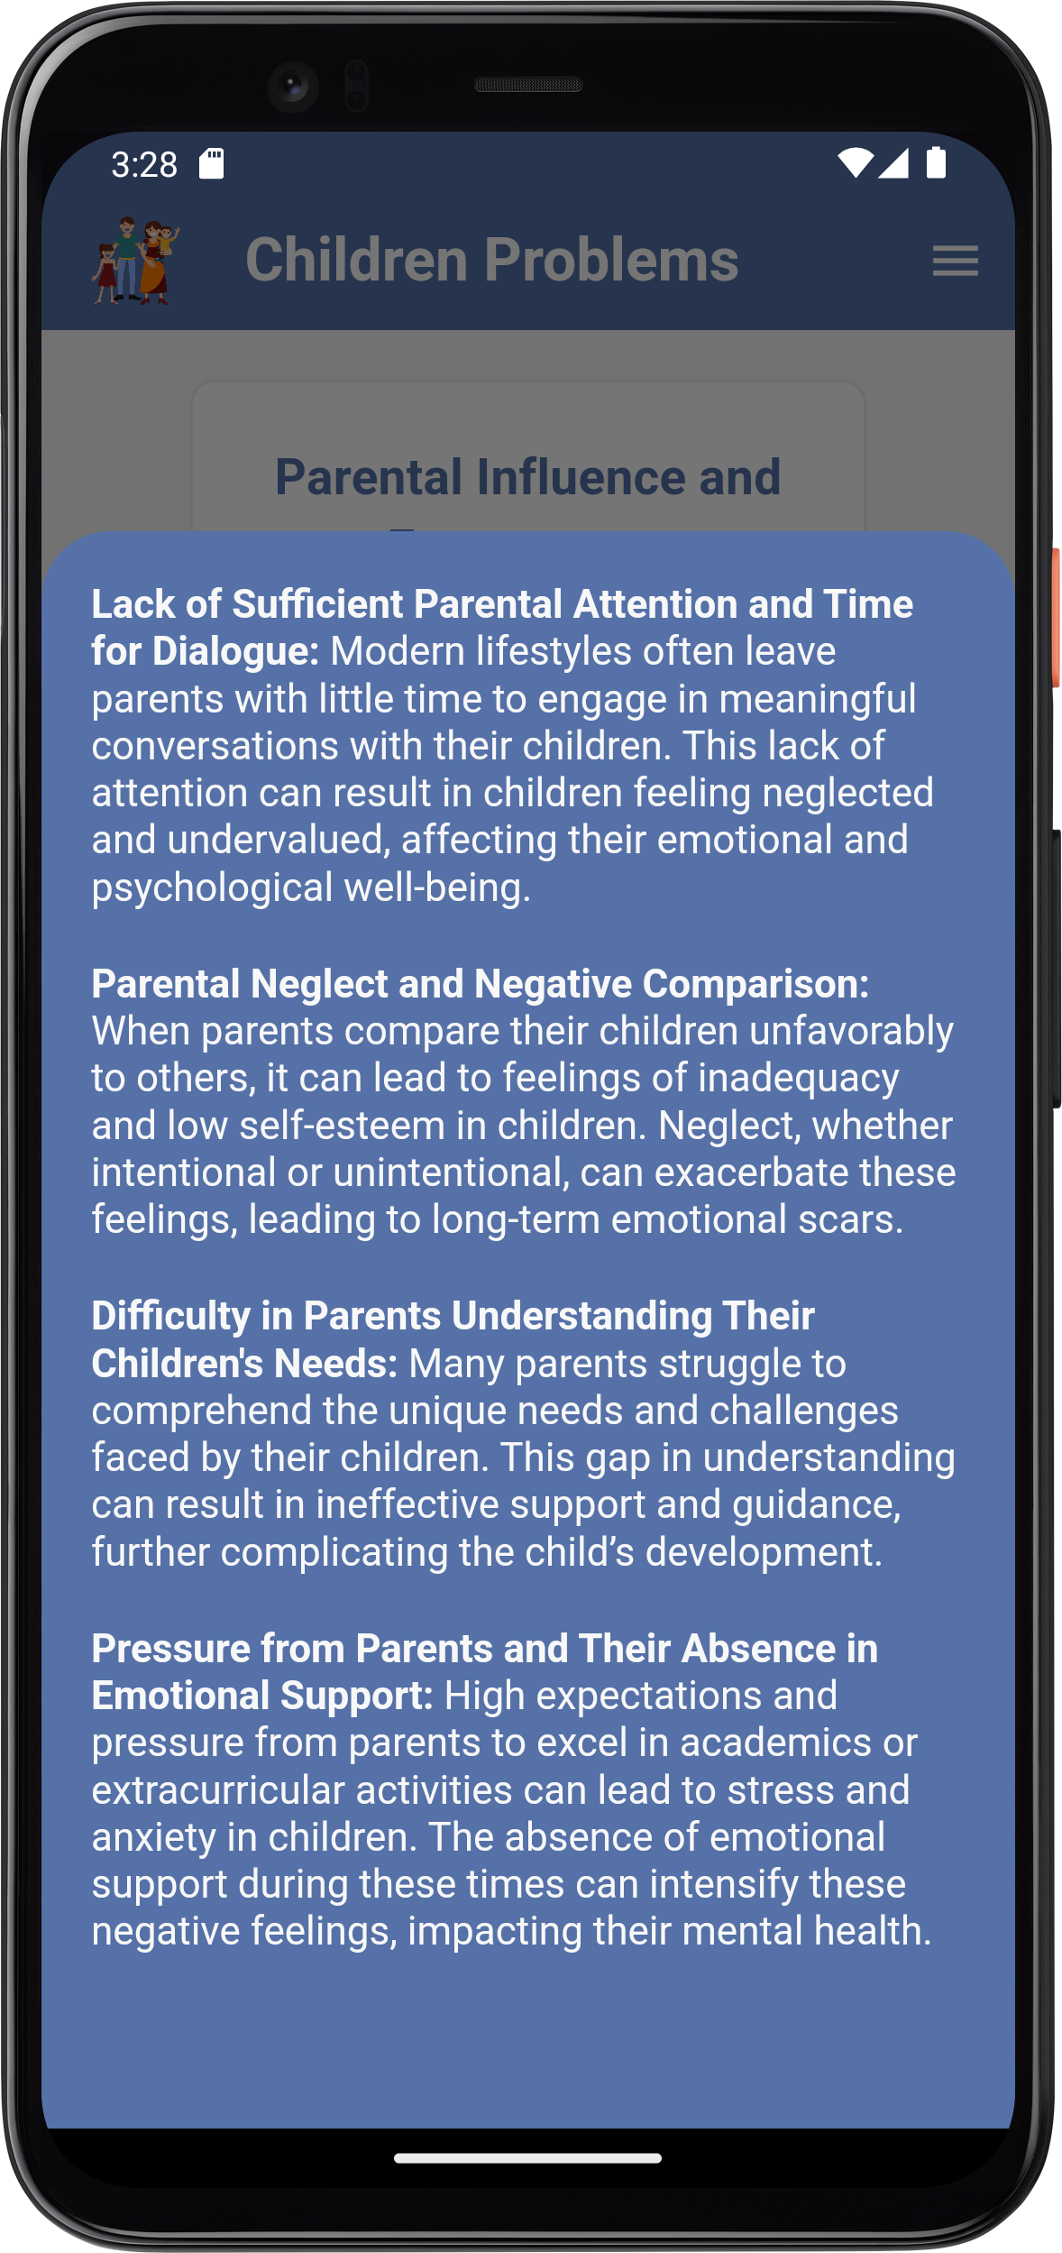
Problem Categorization
Users can read about some problems that face their children or face them as parents and read about common issues that happen among children and also have info about some special issues that need more consideration by the community and require more community support

Slide 42
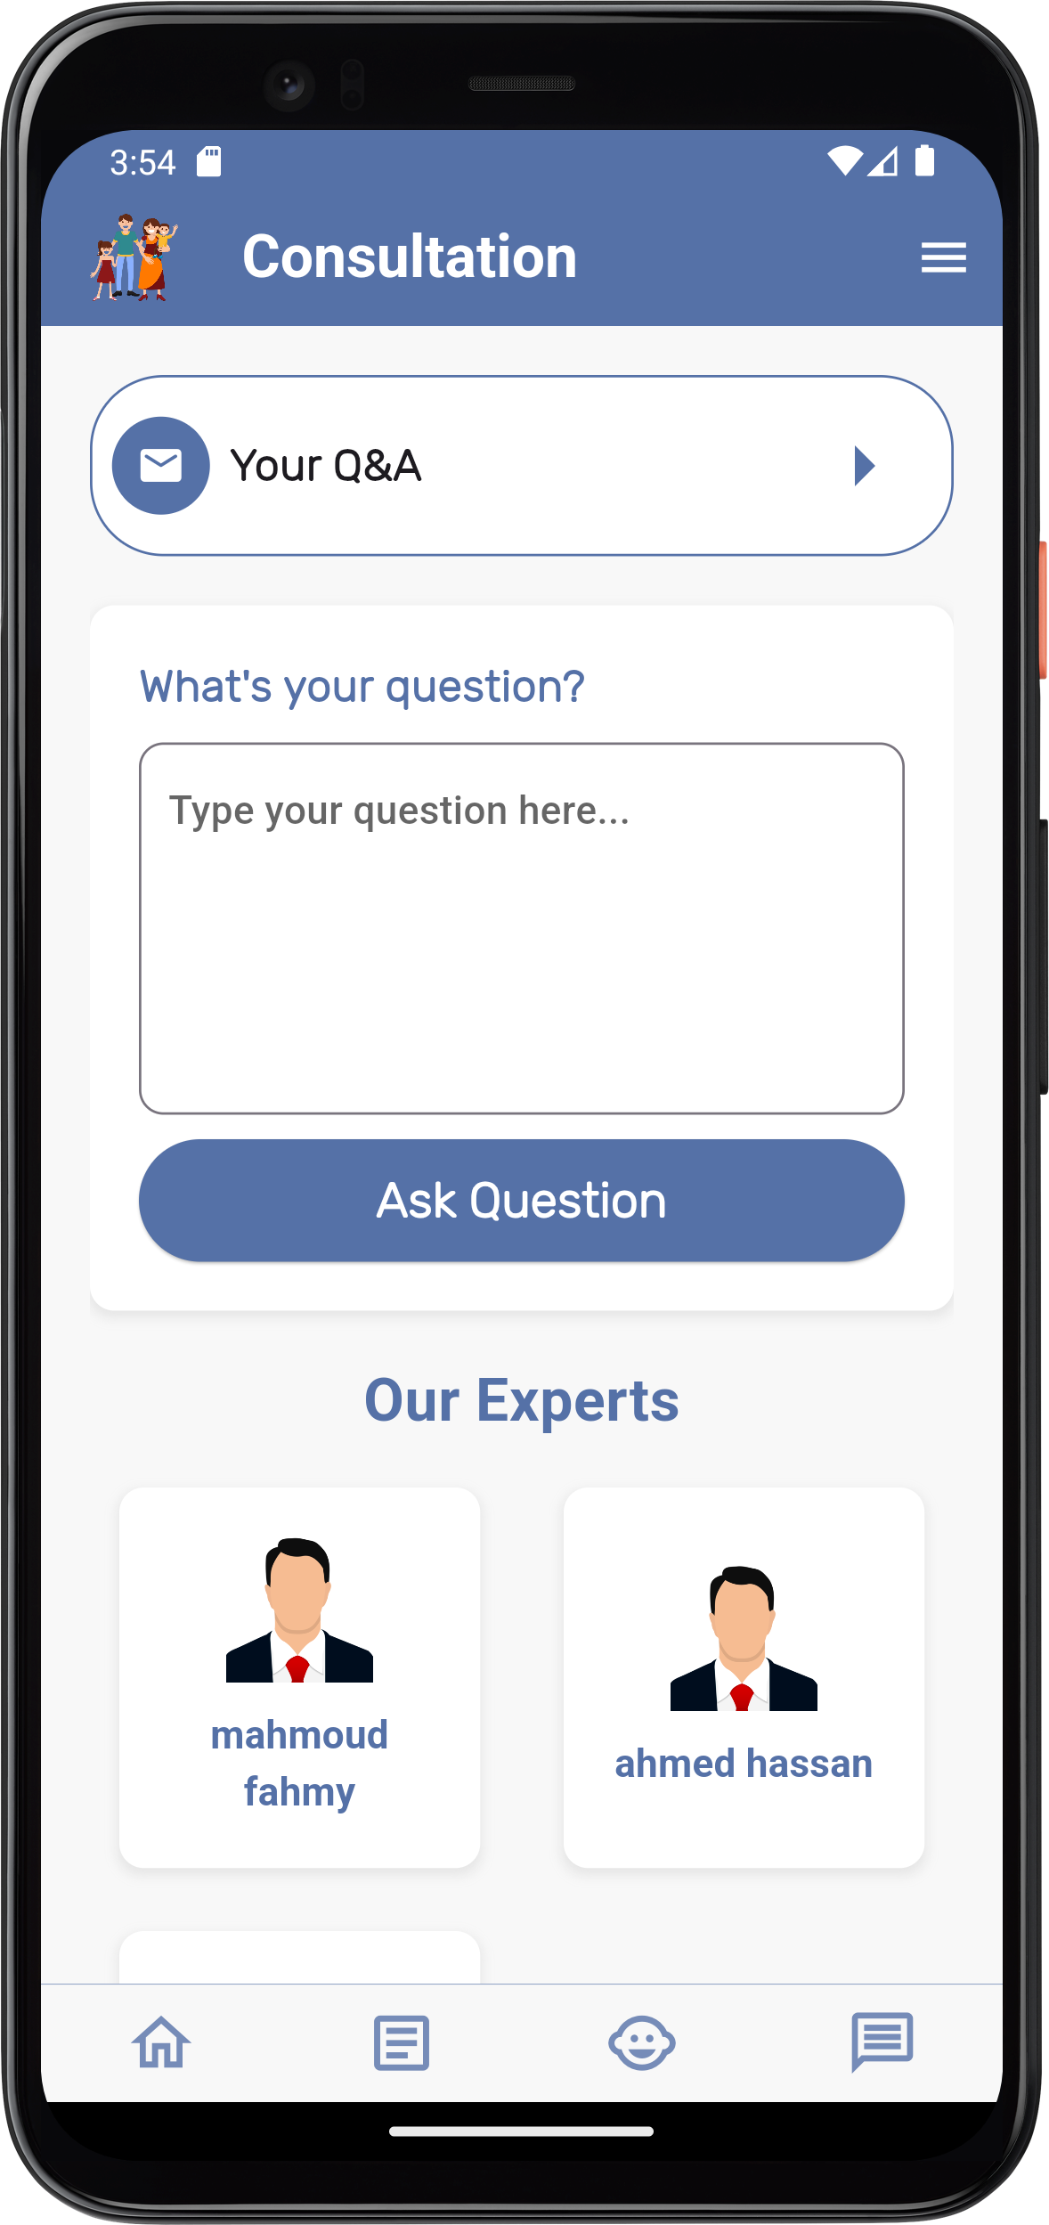
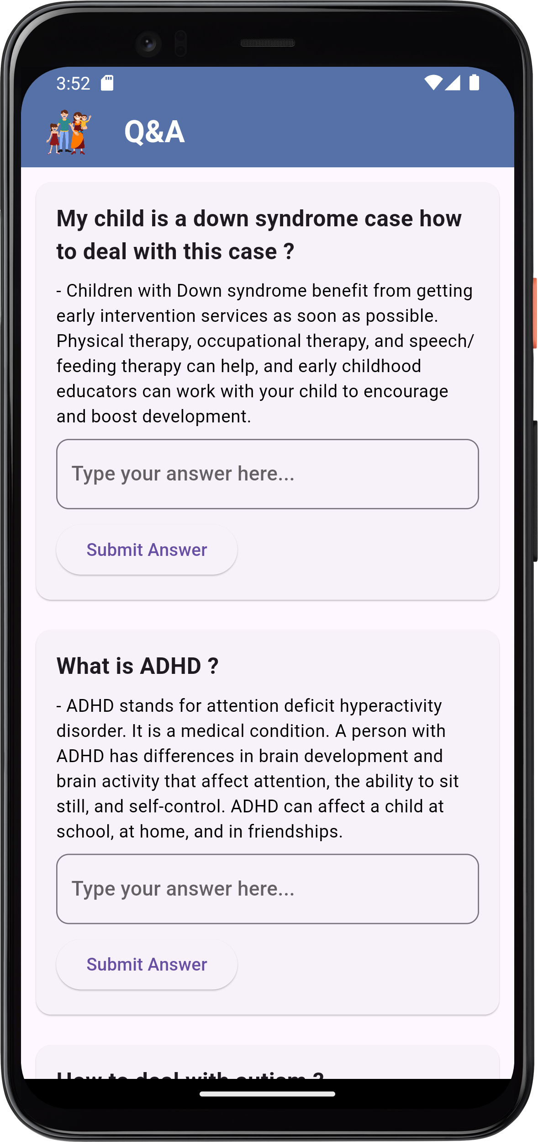
Consultation
The consultation page lets users to ask their questions and shows the users who logged in to our application as consultants which upload their license while logging in to verify their identity
Q&A
Parents can ask questions to other parents or consultants, and also, they can add answers to these questions

Slide 43
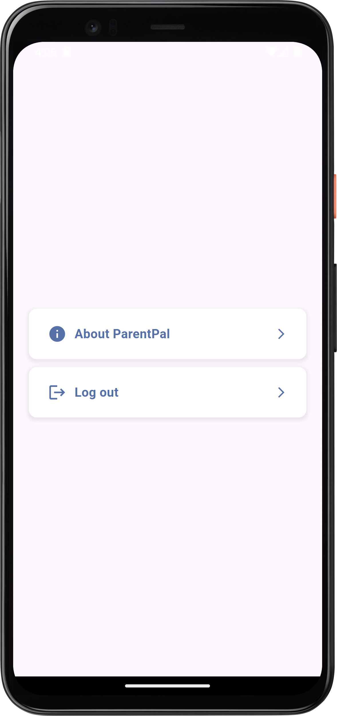
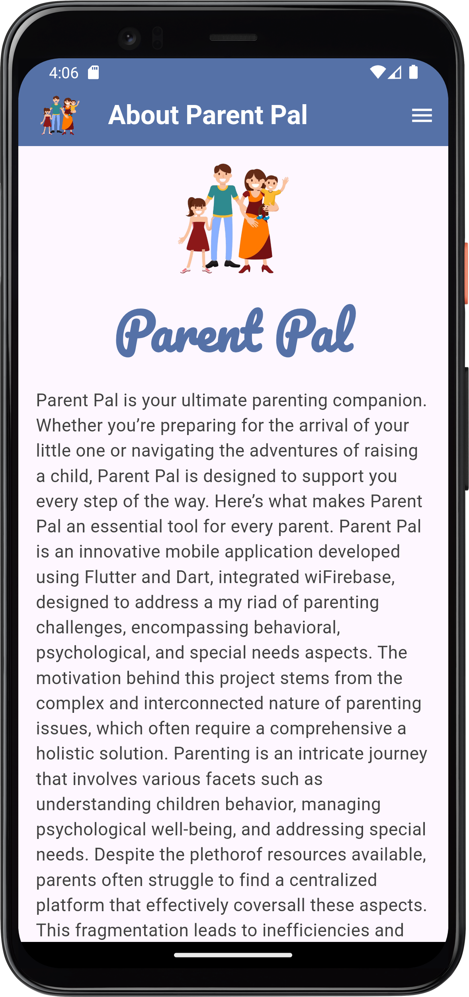
Users can know more about our application and log out from the app
Menu

Slide 44
Future Work
Consultant Ratings: Introduce a rating system for users to rate and review consultants, enhancing the selection process for future users.
List Schools Based on Their Ranking: Provide a feature to list schools based on their rankings, allowing users to find top-rated schools easily.
Improve UI: Improve the user interface to offer a more intuitive and visually appealing experience.
Receive Notifications: Implement a notification system to keep users informed about important updates, new content, and reminders.
Favorites section: Allow users to save and favorite articles for easy access and future reference.
Improve Application Security: Enhance the security measures to protect user data and ensure a safe browsing experience.
AI-Powered Assistant: Integrate an AI-powered assistant to answer user questions, complete tasks, and personalize the app experience.
Resolve Application Bugs: Address and fix existing bugs to improve the overall functionality and user experience of the application.

Slide 45
Thank You !

